Slide 1
An NSS Audio-Visual
Library Presentation
The Magic Hollow
Mountain – Fern Cave
John Van Swearingen IV (1994)
S744 90 Slides 2/12/2021

Slide 3
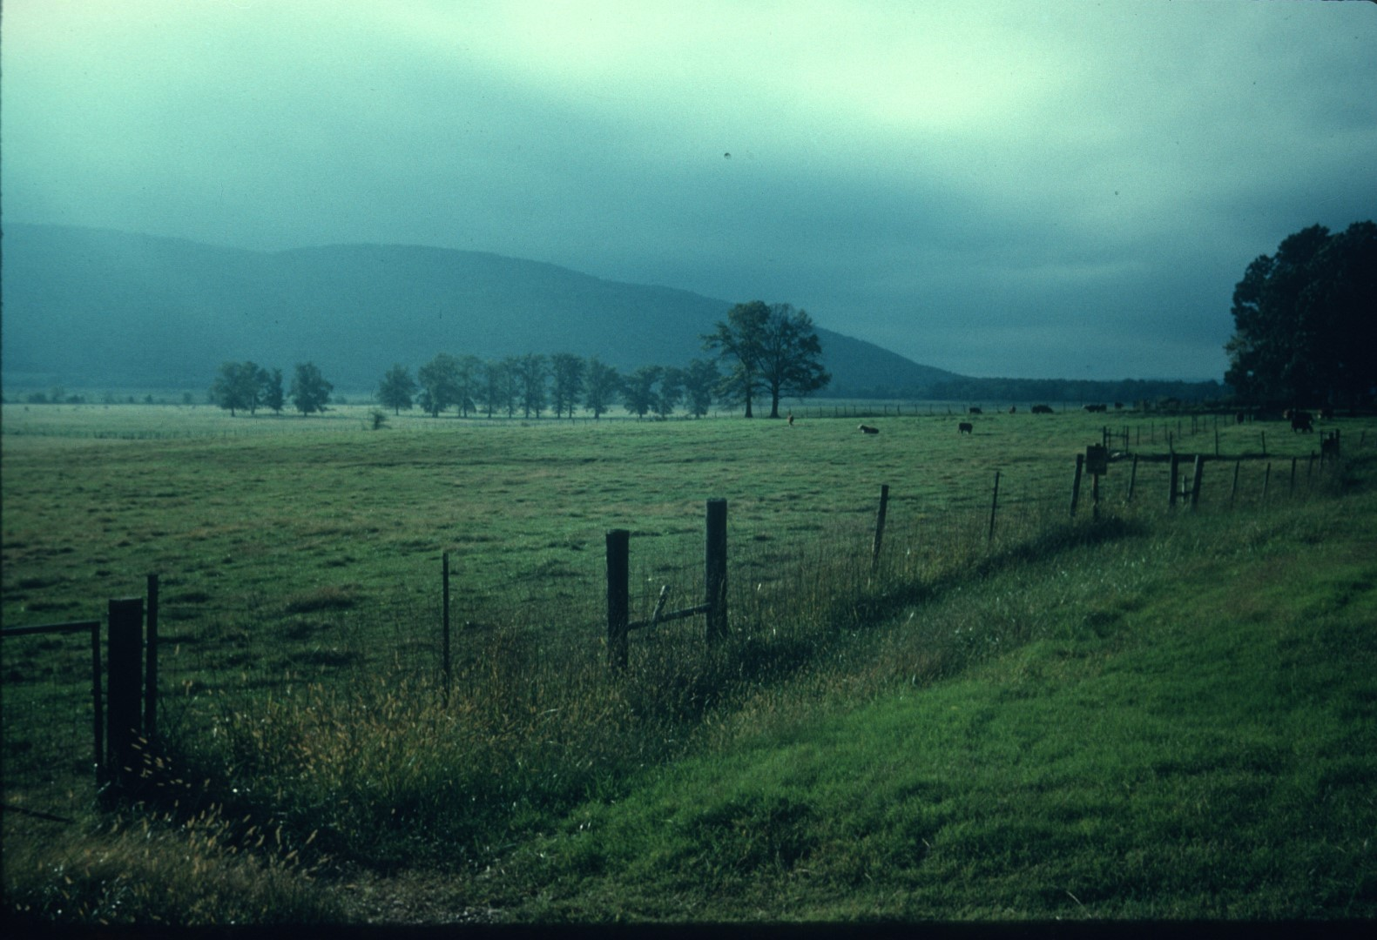
Notes:
Fern cave is contained within Nat Mountain, shown on a misty autumn morning. We are in Jackson County in northern Alabama.

Slide 4
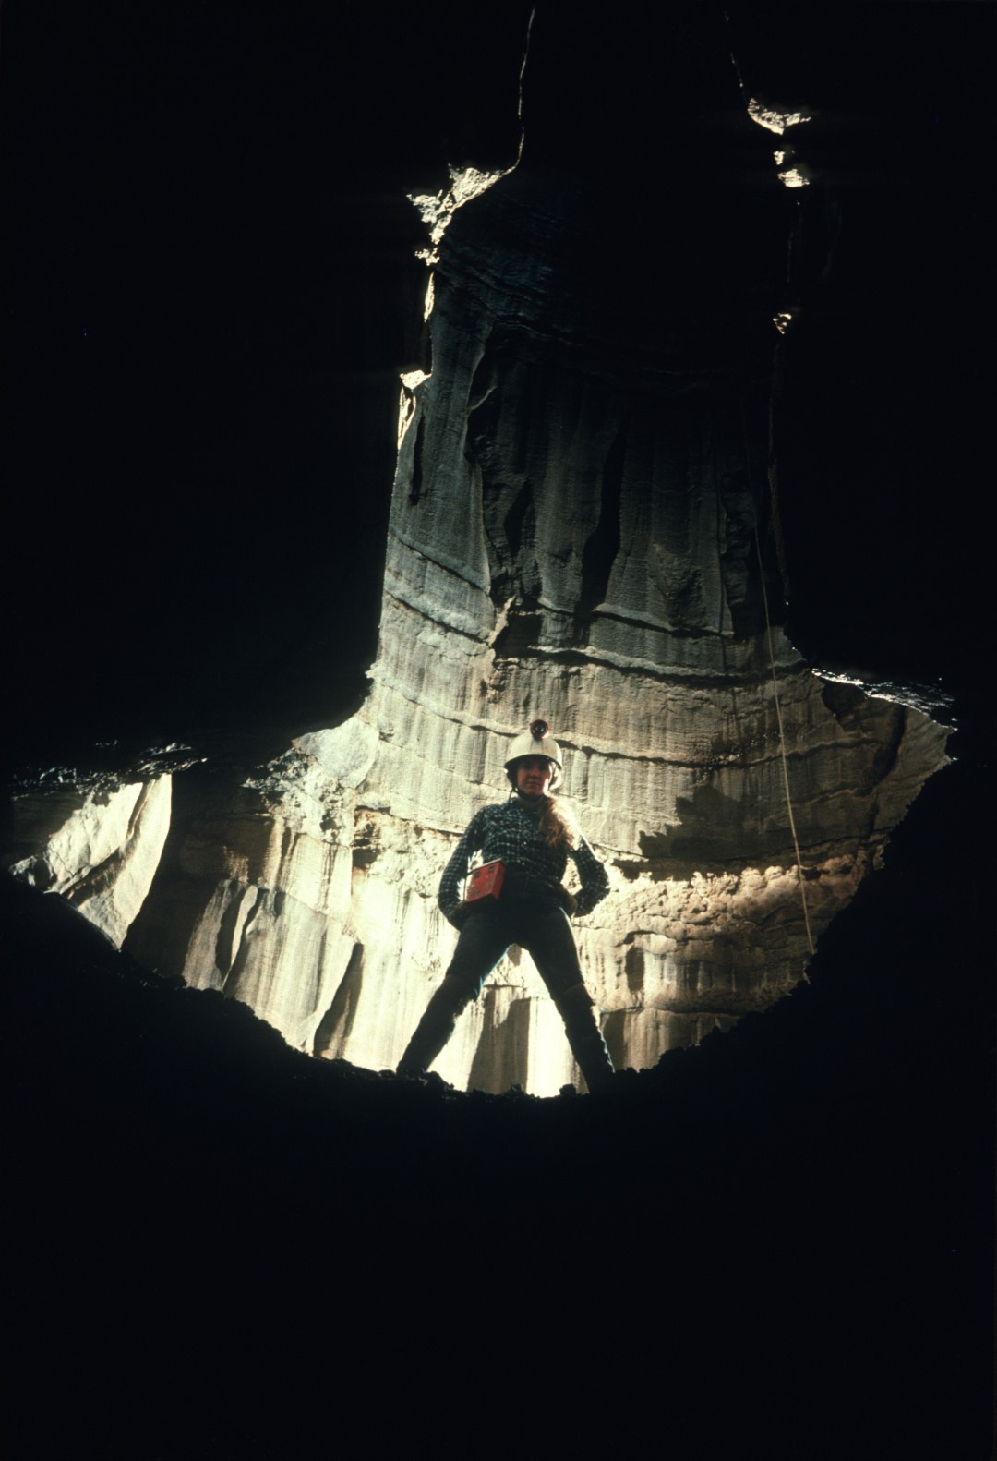
Notes:
The cave is certainly one of the more diverse caves in the Southeast.

Slide 5
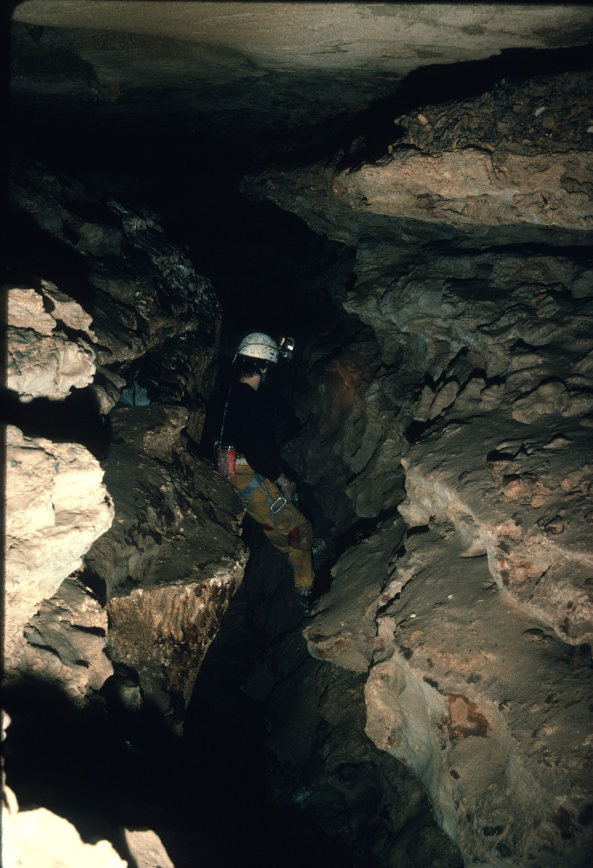
Notes:
The vast majority of the cave appears very similar to the scene depicted here; however ...

Slide 6
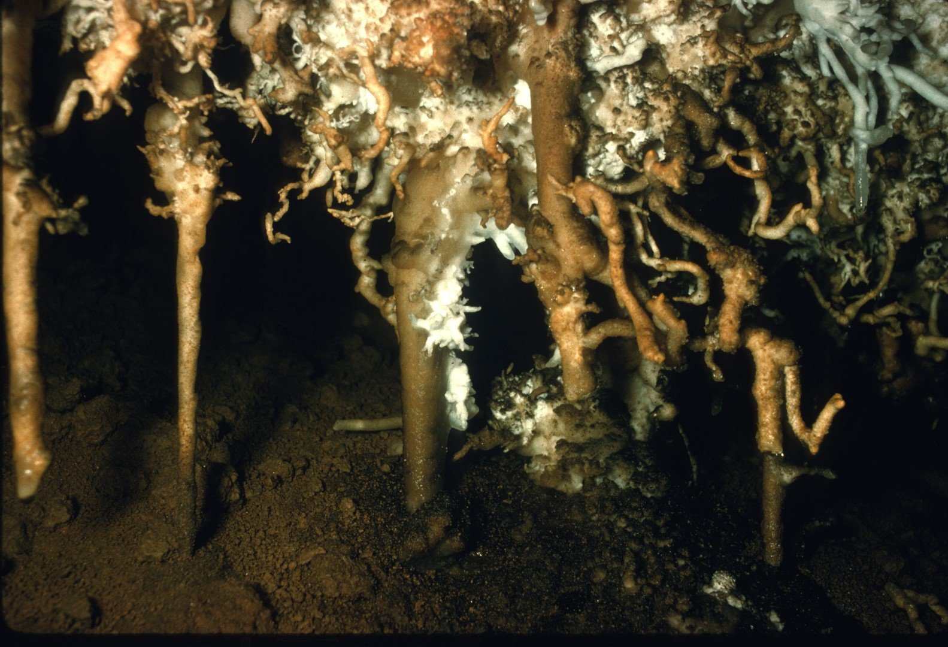
Notes:
…many wonderful anomalies occur, making it a splendid cave system.

Slide 7
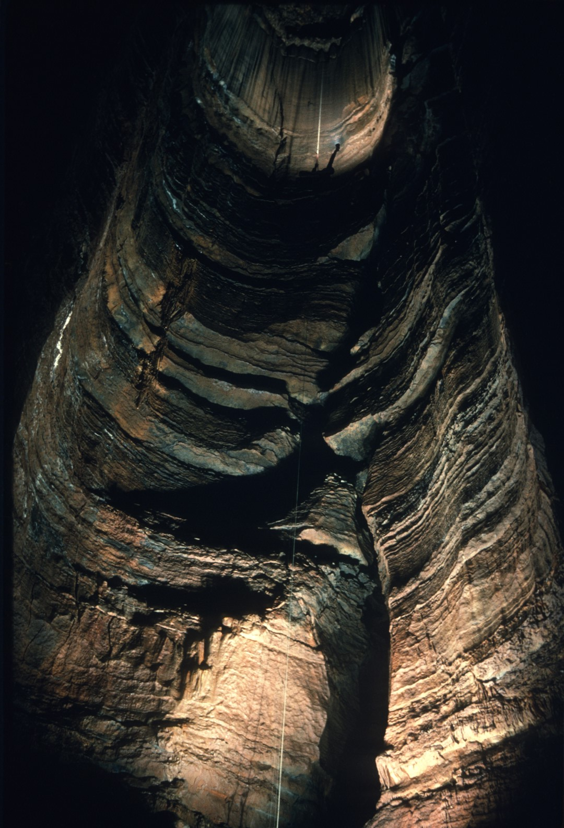
Notes:
Such as the 110-foot deep Coney's Chasm here depicted.

Slide 8
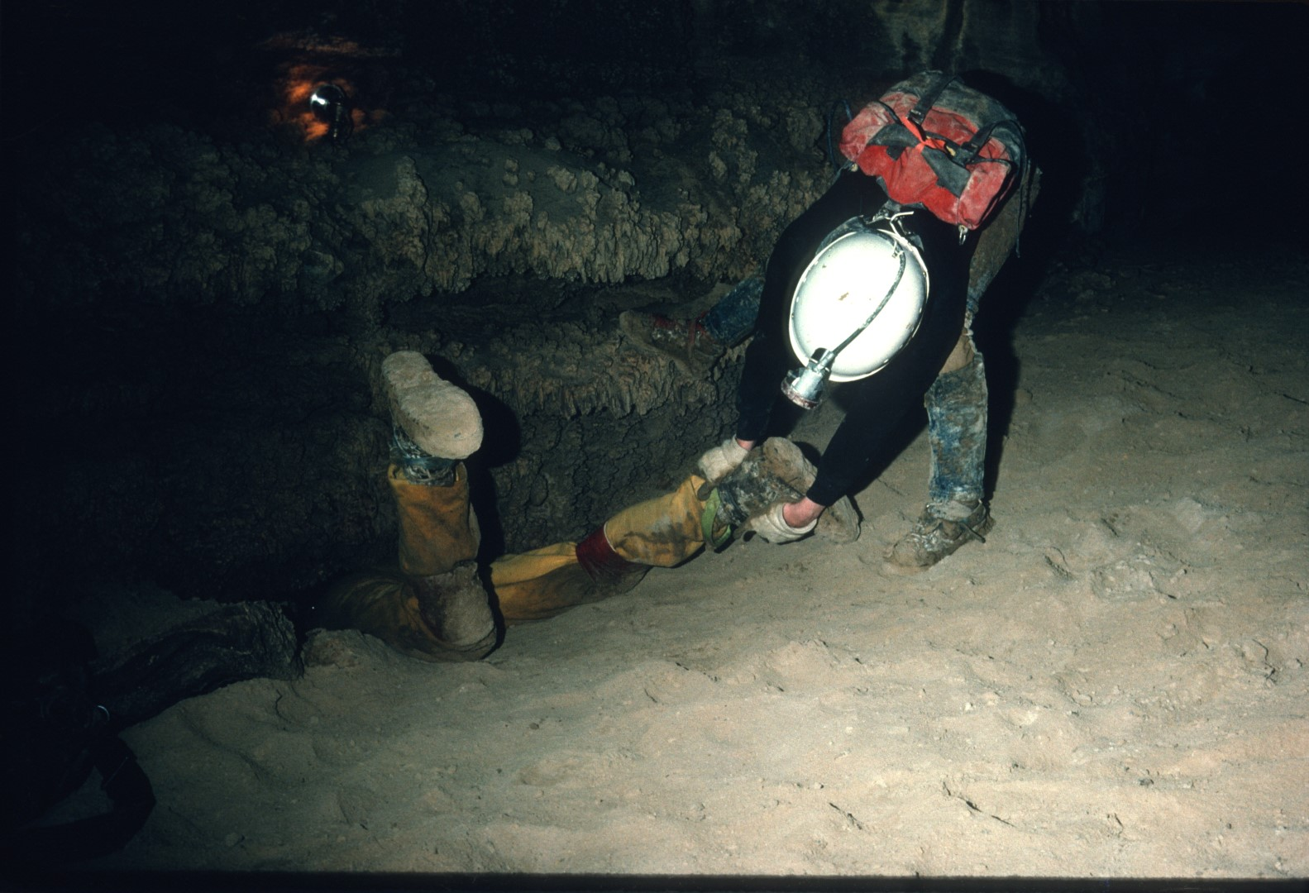
Notes:
Even though it has been over 31 years since the cave was discovered, exploration continues ...

Slide 9
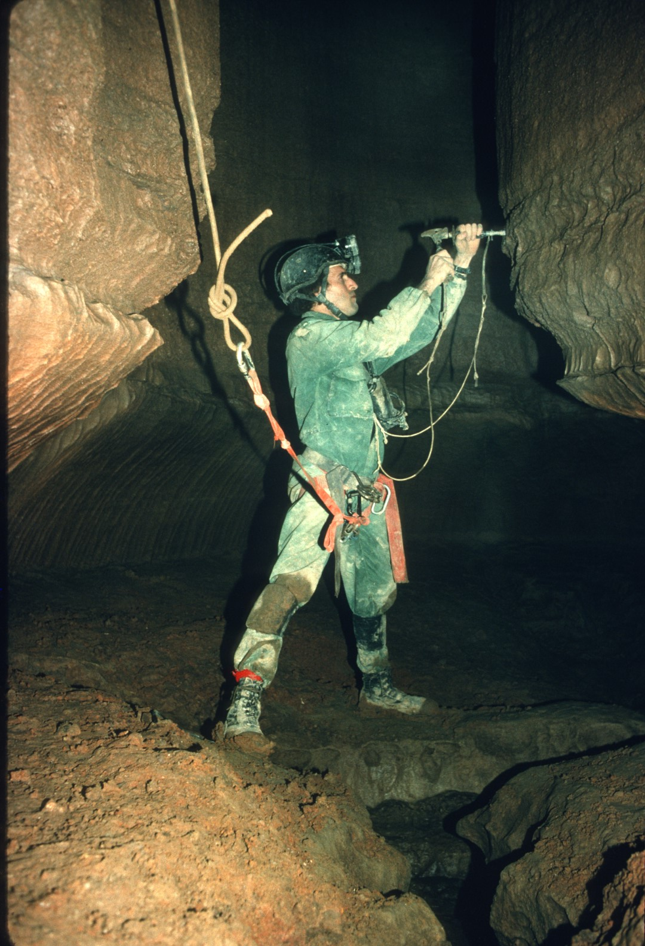
Notes:
…and discoveries are still being made.

Slide 10
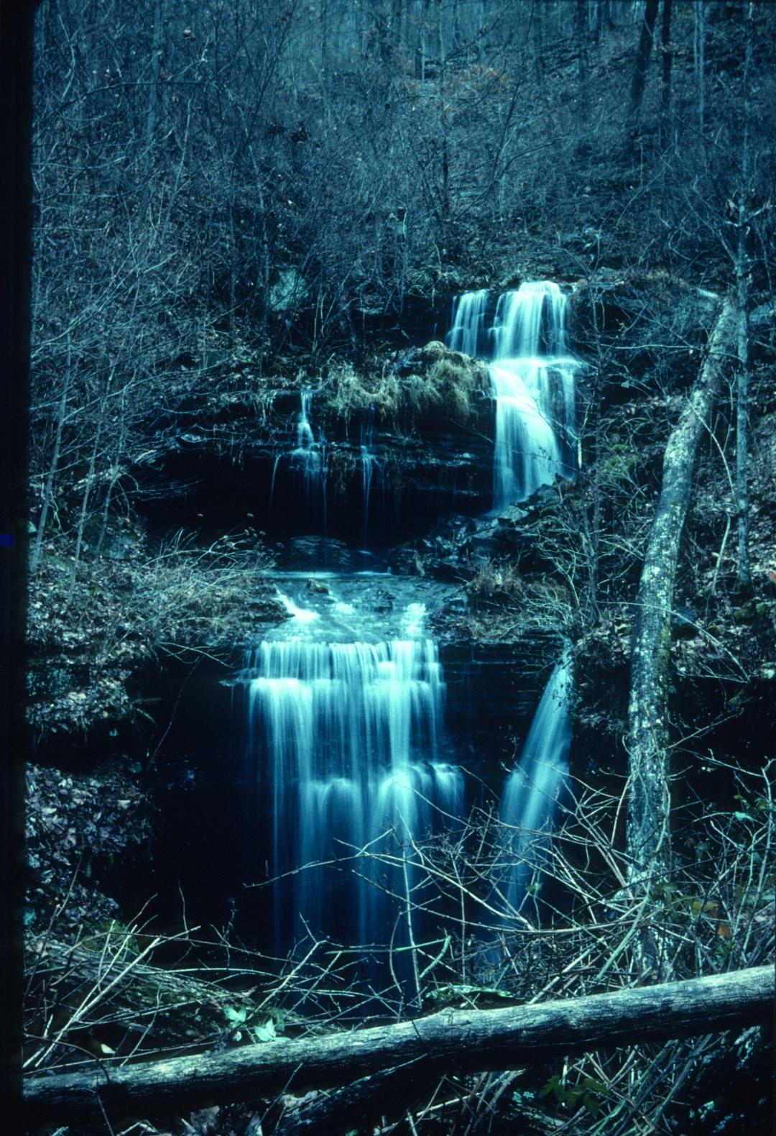
Notes:
Many visitors to Fern Cave are only aware of the Fern sink, so named, because of the proliferation of Ferns In the area.

Slide 11
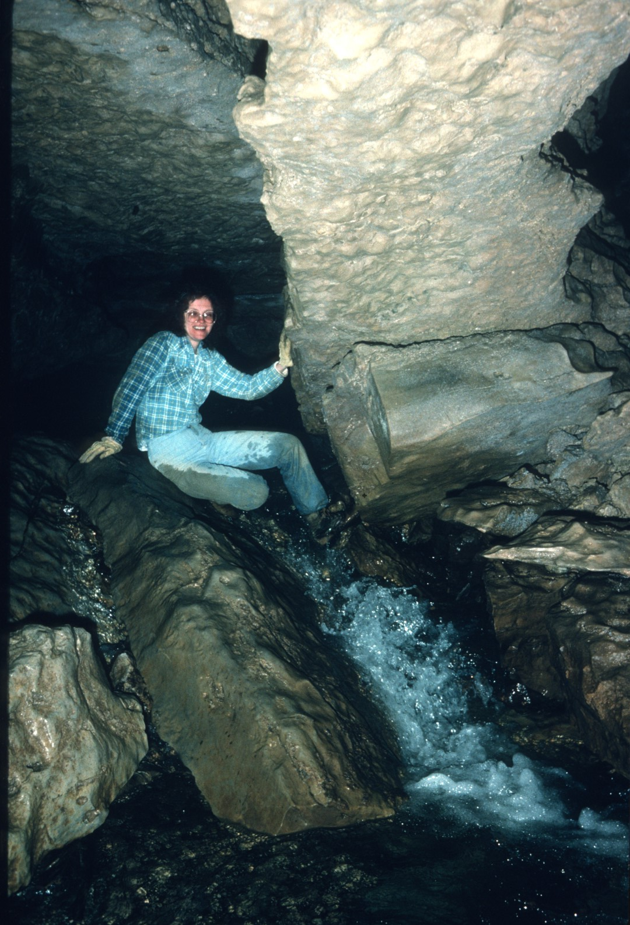
Notes:
From the sink entrance, water cascades down a simple unadorned stream passage.

Slide 12
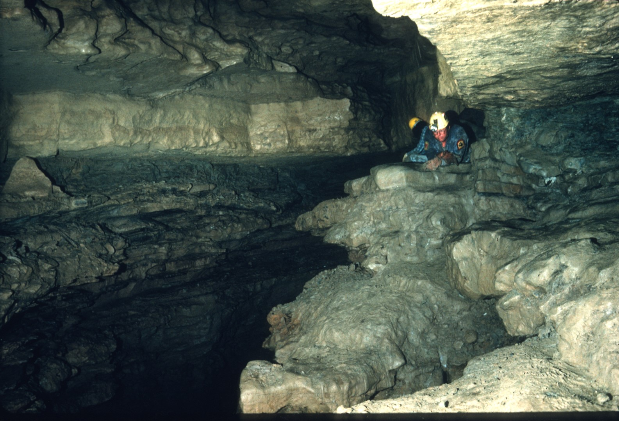
Notes:
Bill Torode, followed by Jim Johnston, was most likely the first to see this part or the cave.

Slide 13
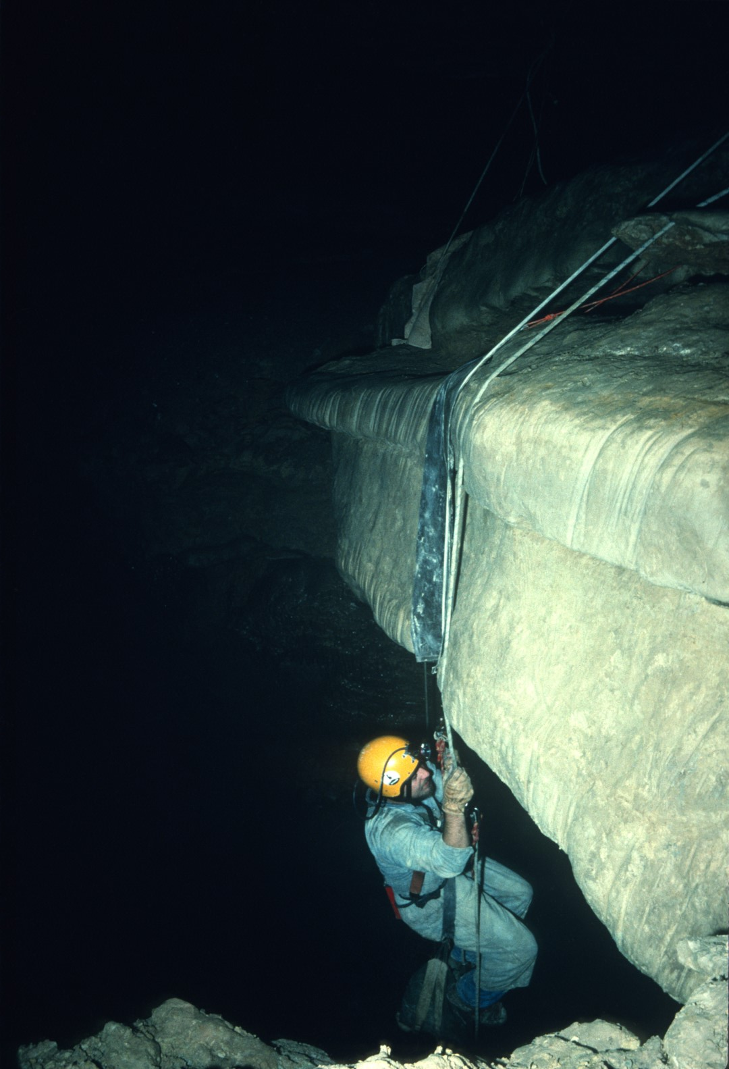
Notes:
Bill exclaimed, "We have a pit!" Jim retorted by saying, "We've got rope coming." Bill's response was, "If we tie every rope that we have with us today, we're still not getting down this thing!"

Slide 14
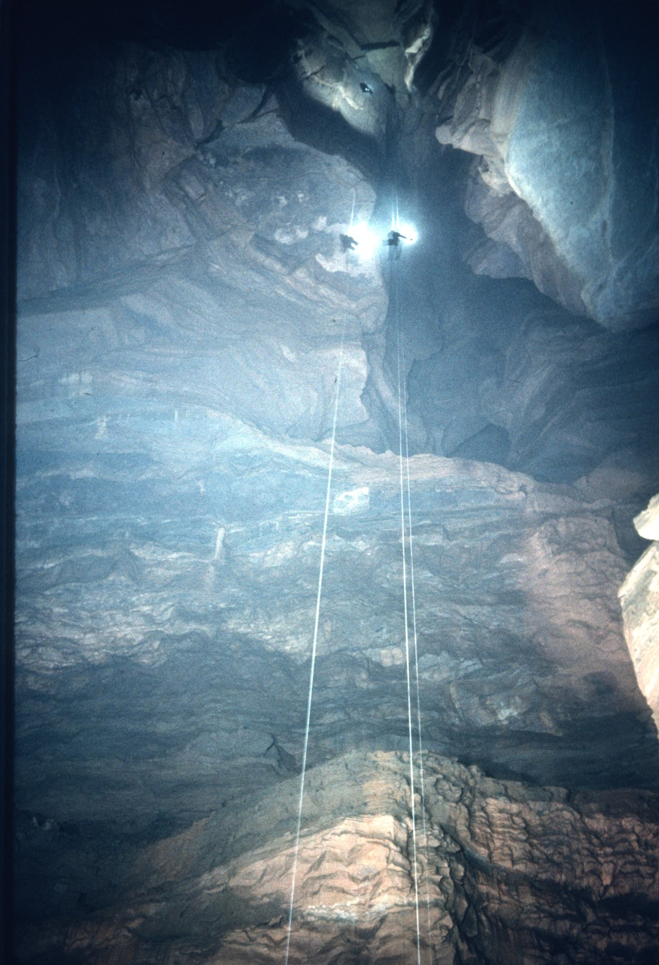
Notes:
It was only later when the drop was first descended by Bill Cuddington that the awesome size of Surprise Pit was realized. At the Initial rig point, it was 437 feet deep.

Slide 15
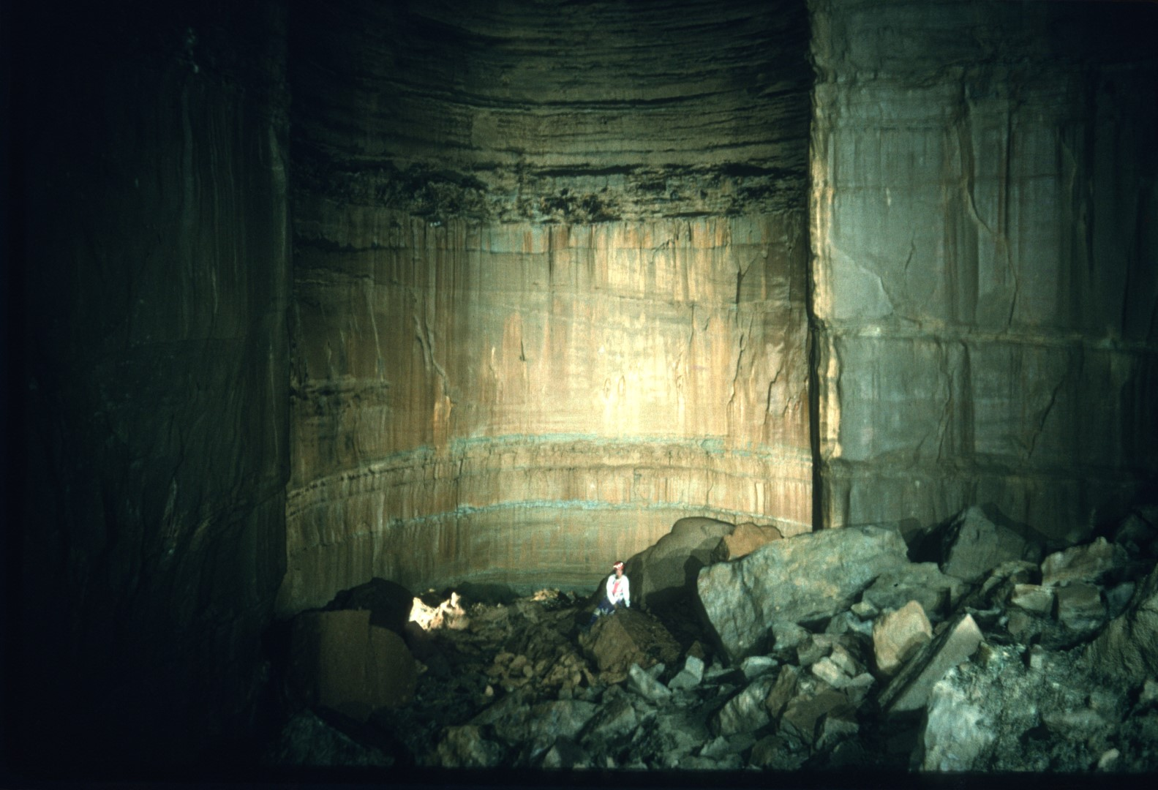
Notes:
This picture depicts less than half of the floor space of Surprise Pit.

Slide 16
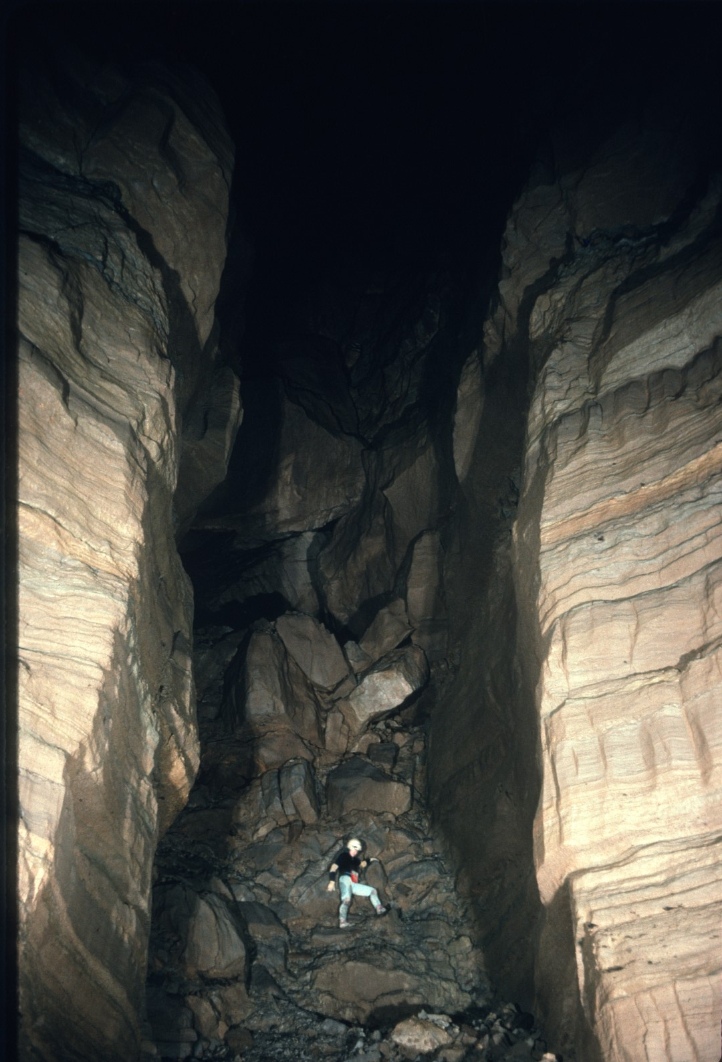
Notes:
This massive boulder choke on the floor of the pit thwarted further exploration for many years.

Slide 17
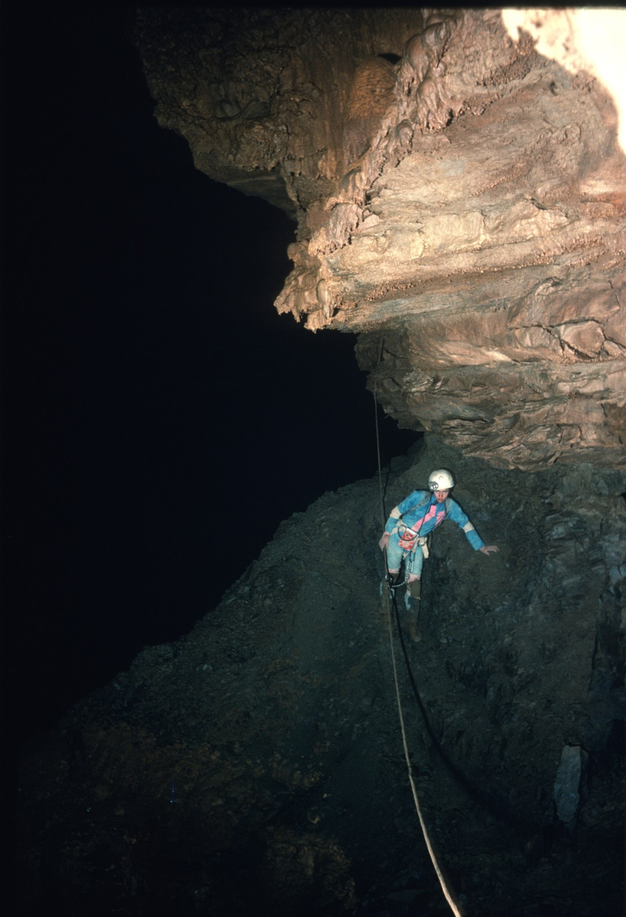
Notes:
In 1971, Bill Torode pioneered a new rig point from the top and rappelled halfway down the drop. By negotiating tricky ledges he ventured into a vast hall that now bears his name.

Slide 18
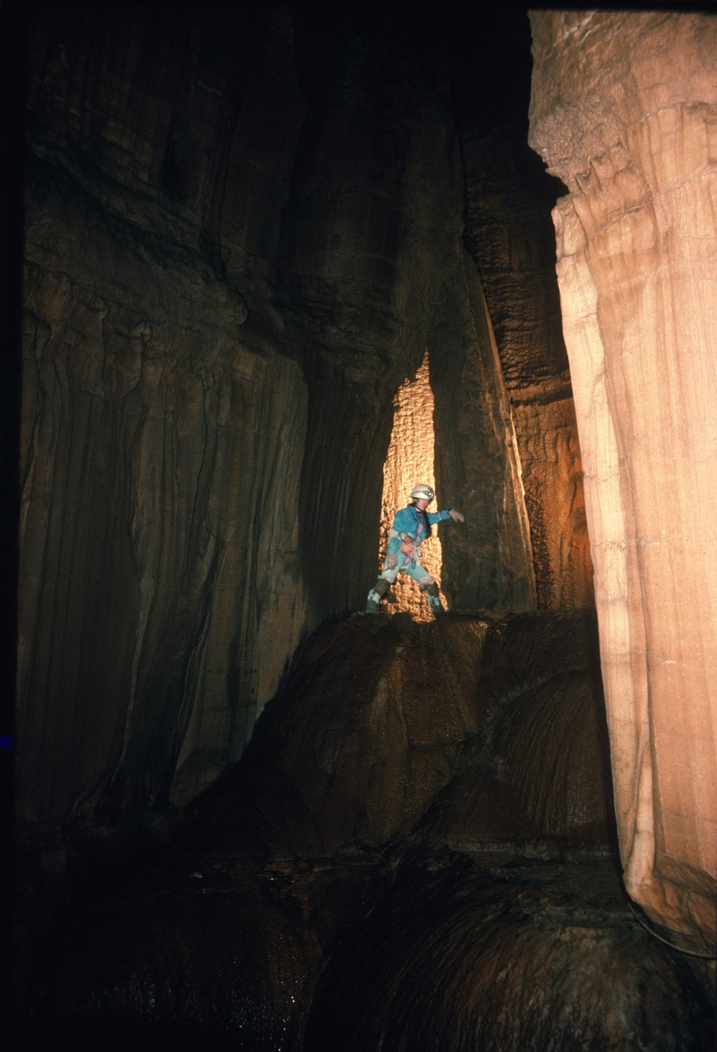
Notes:
It was then realized that Surprise Pit is not really a pit at all, but a 1,000 foot long canyon that is over 400 feet deep in places.

Slide 19
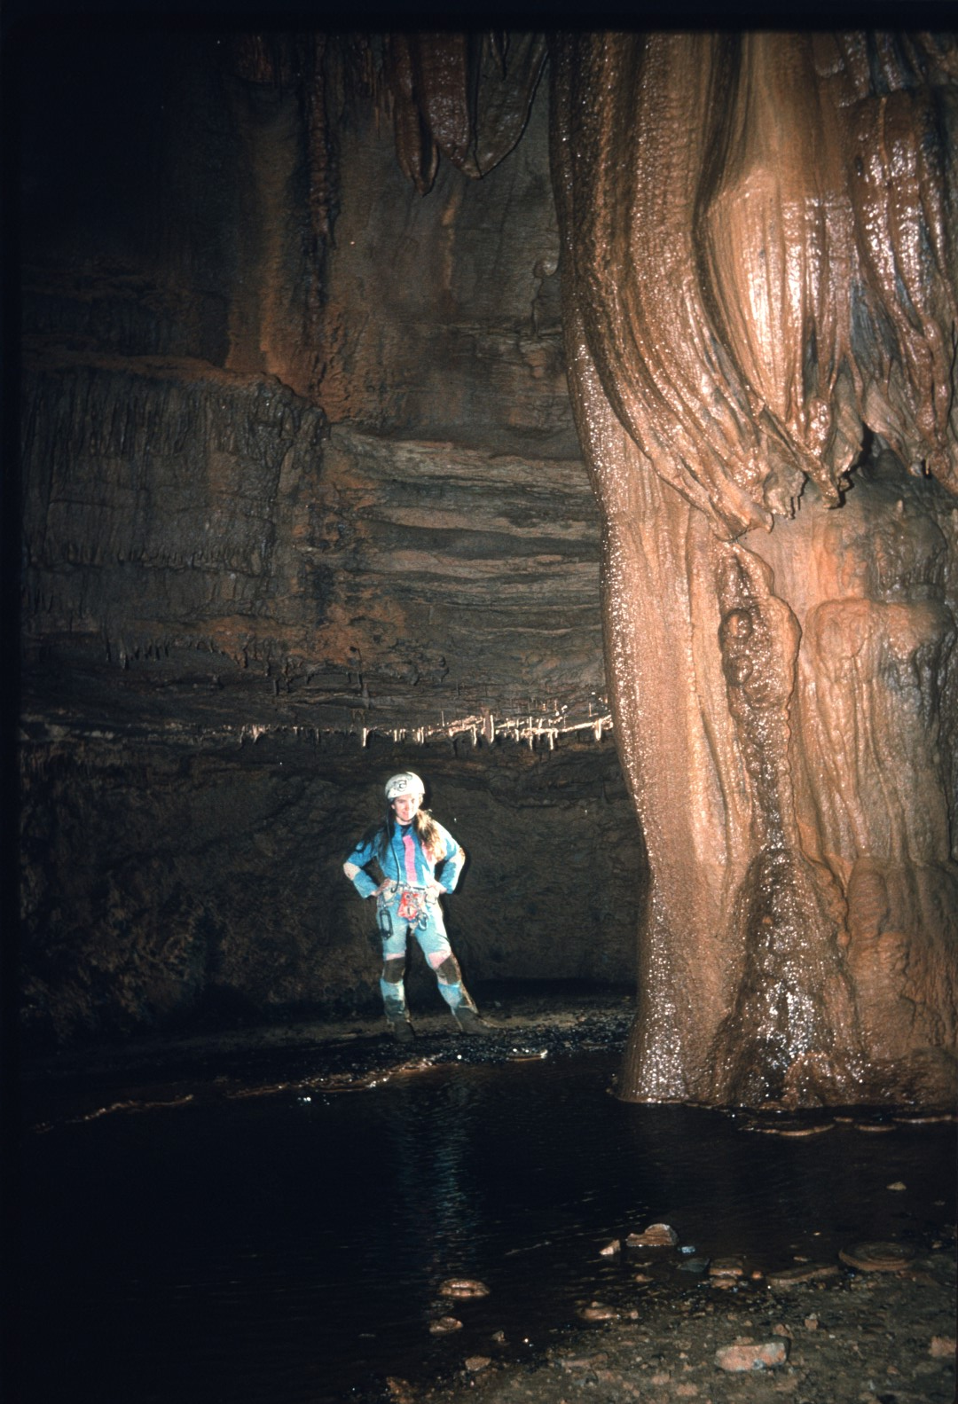
Notes:
Torode Hall is very rarely visited.

Slide 20
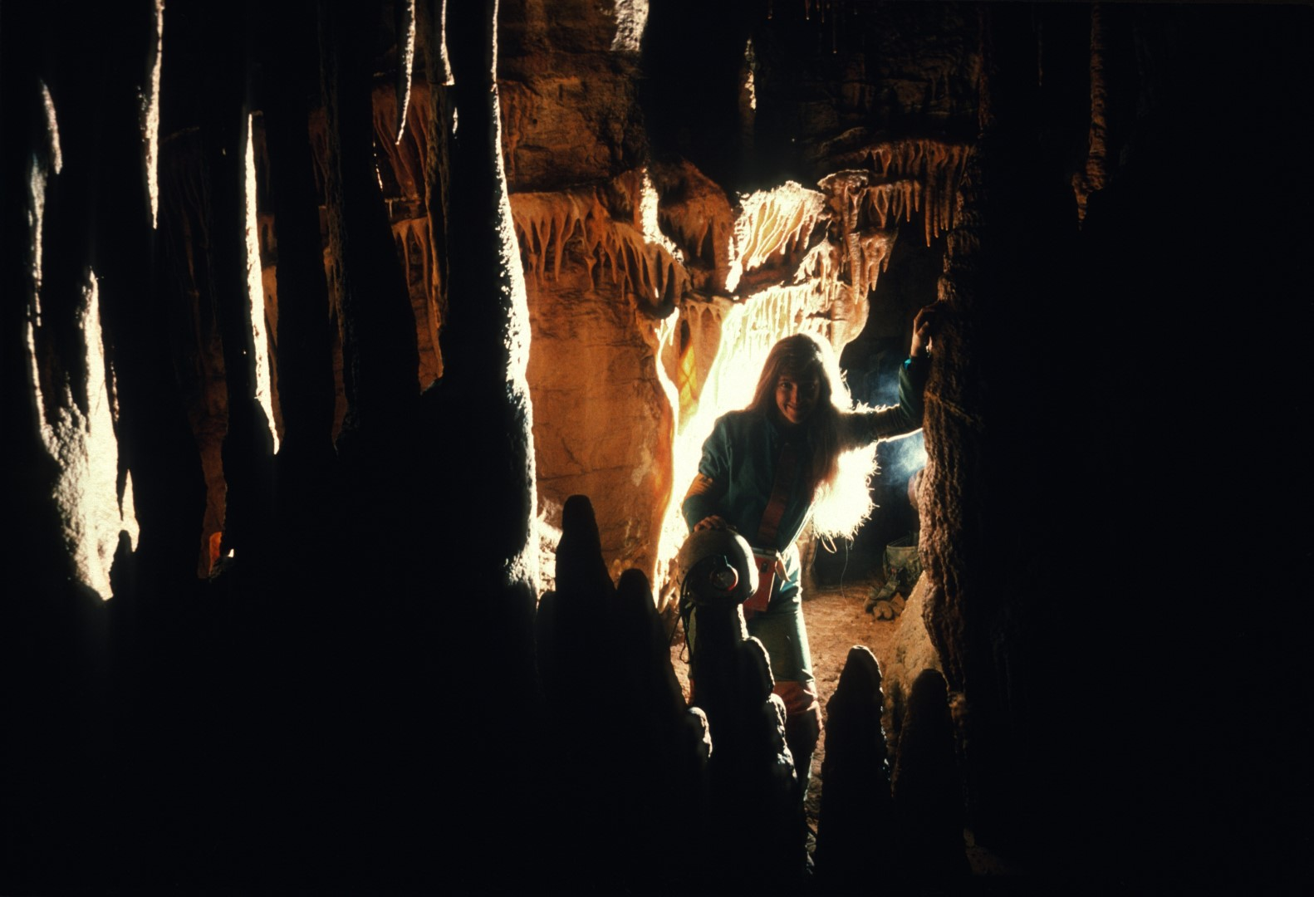
Notes:
But it is a very unique and fascinating area of the cave.

Slide 21
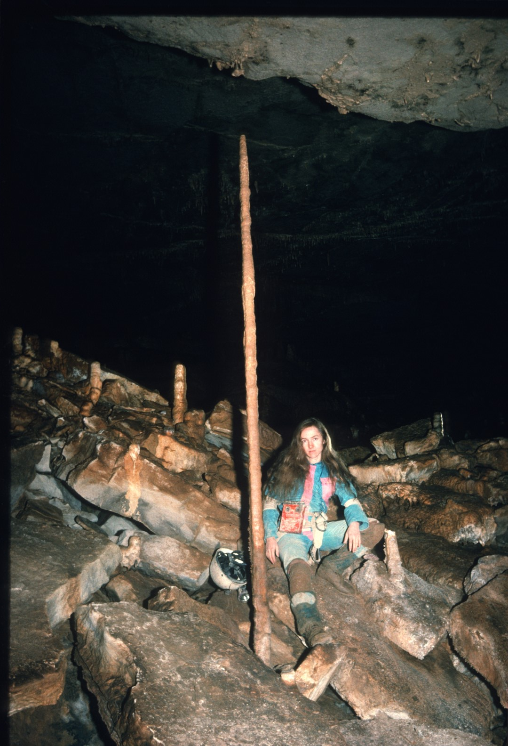
Notes:
It is developed on two distinct levels, which are connected by gaping abysses.

Slide 22
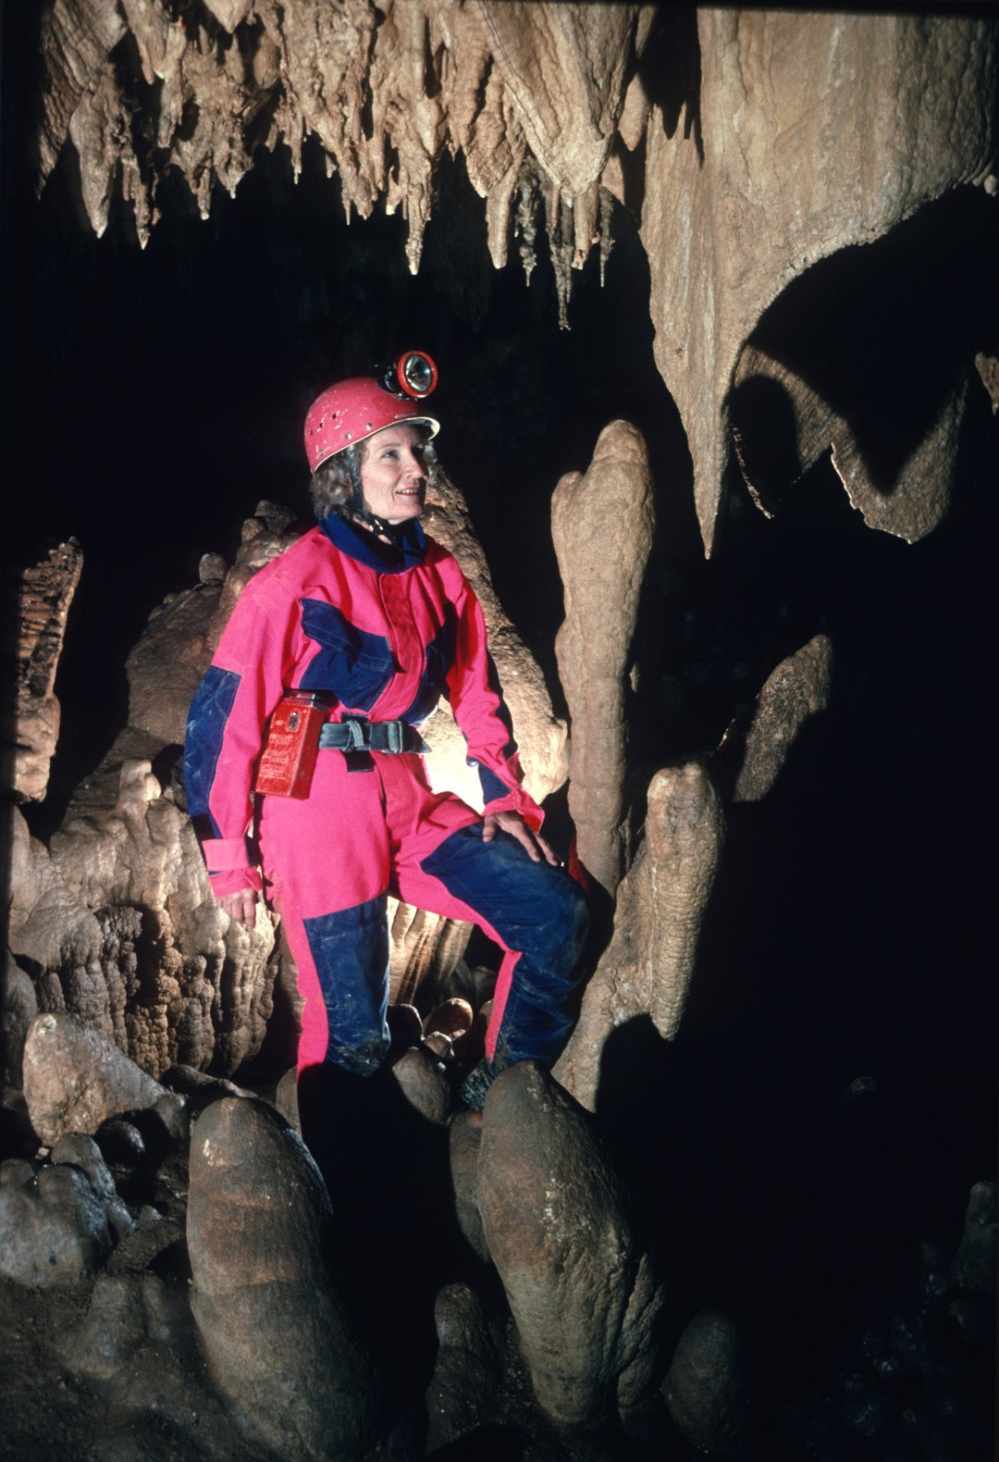
Notes:
It In addition to many delicate formations, It contains many massive ones also.

Slide 23
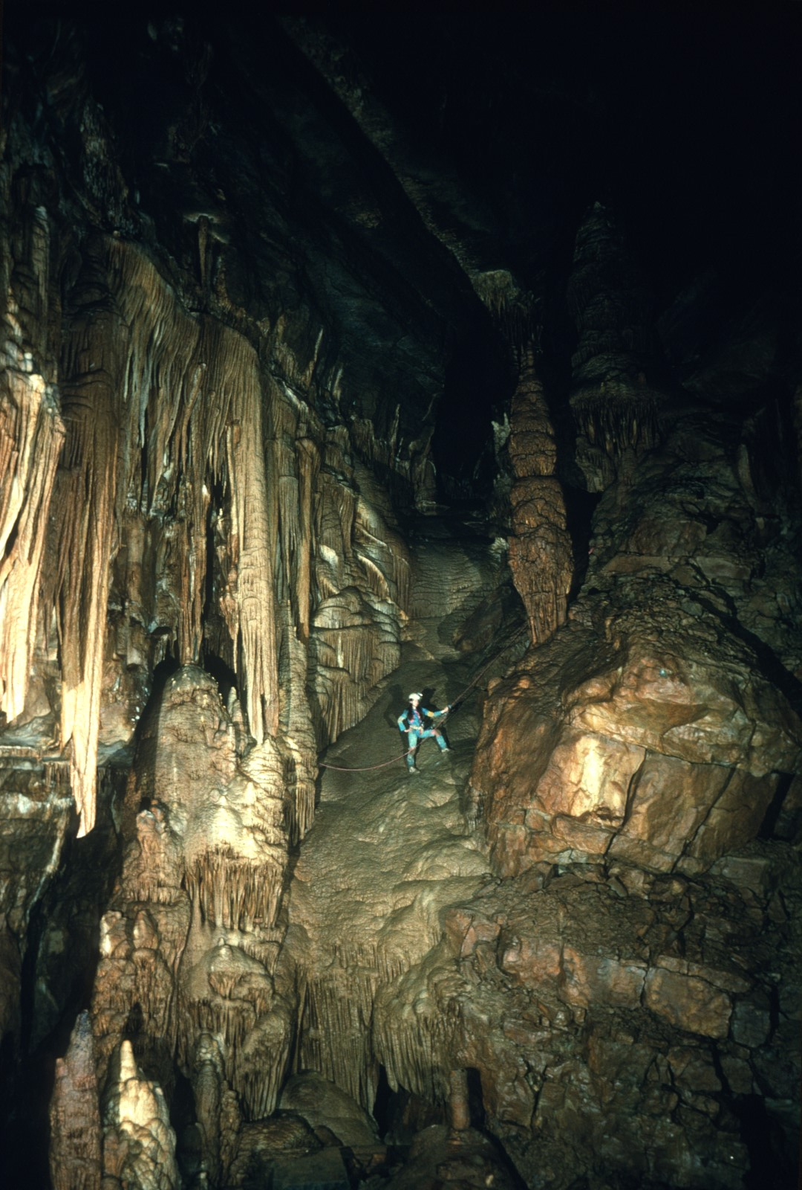
Notes:
The hall terminates in profusely decorated massive flowstone flow.

Slide 24
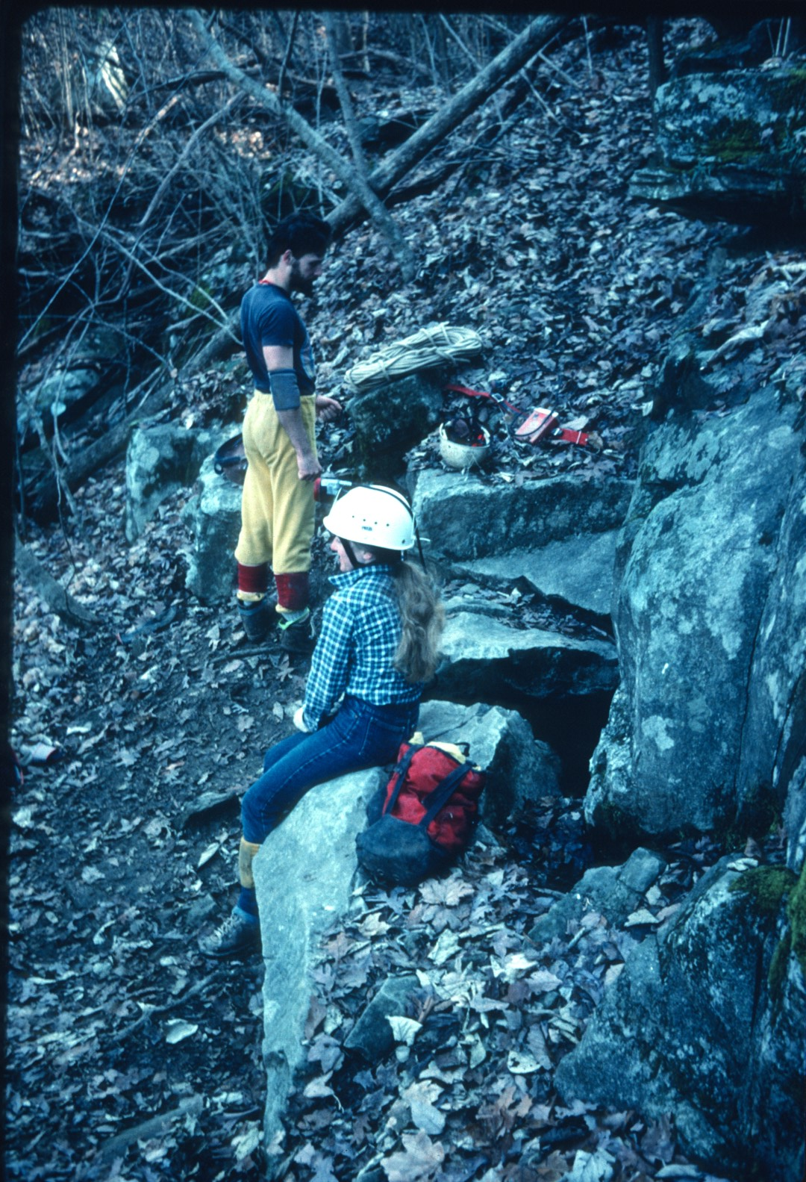
Notes:
In 1969, events reversed themselves and Jim Johnston discovered the entrance that bears his name. Bill Torode was immediately behind him.

Slide 25
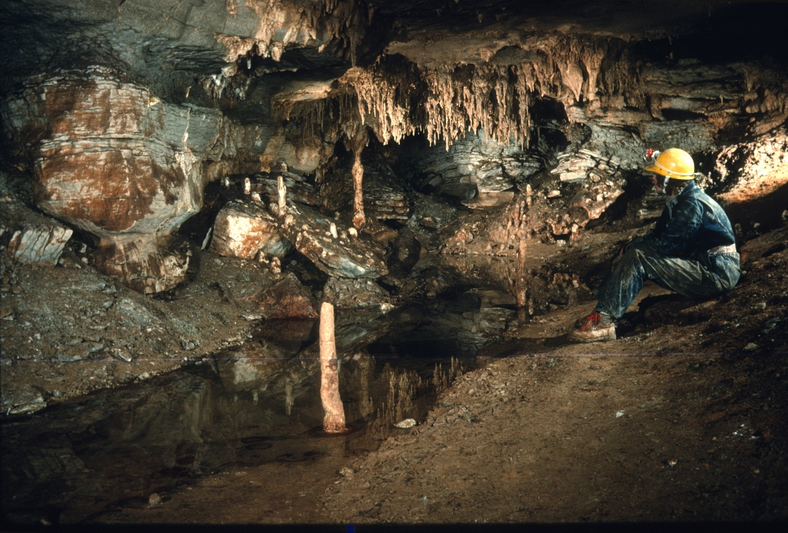
Notes:
The Johnston entrance opened up into a cornucopia of passage.

Slide 26
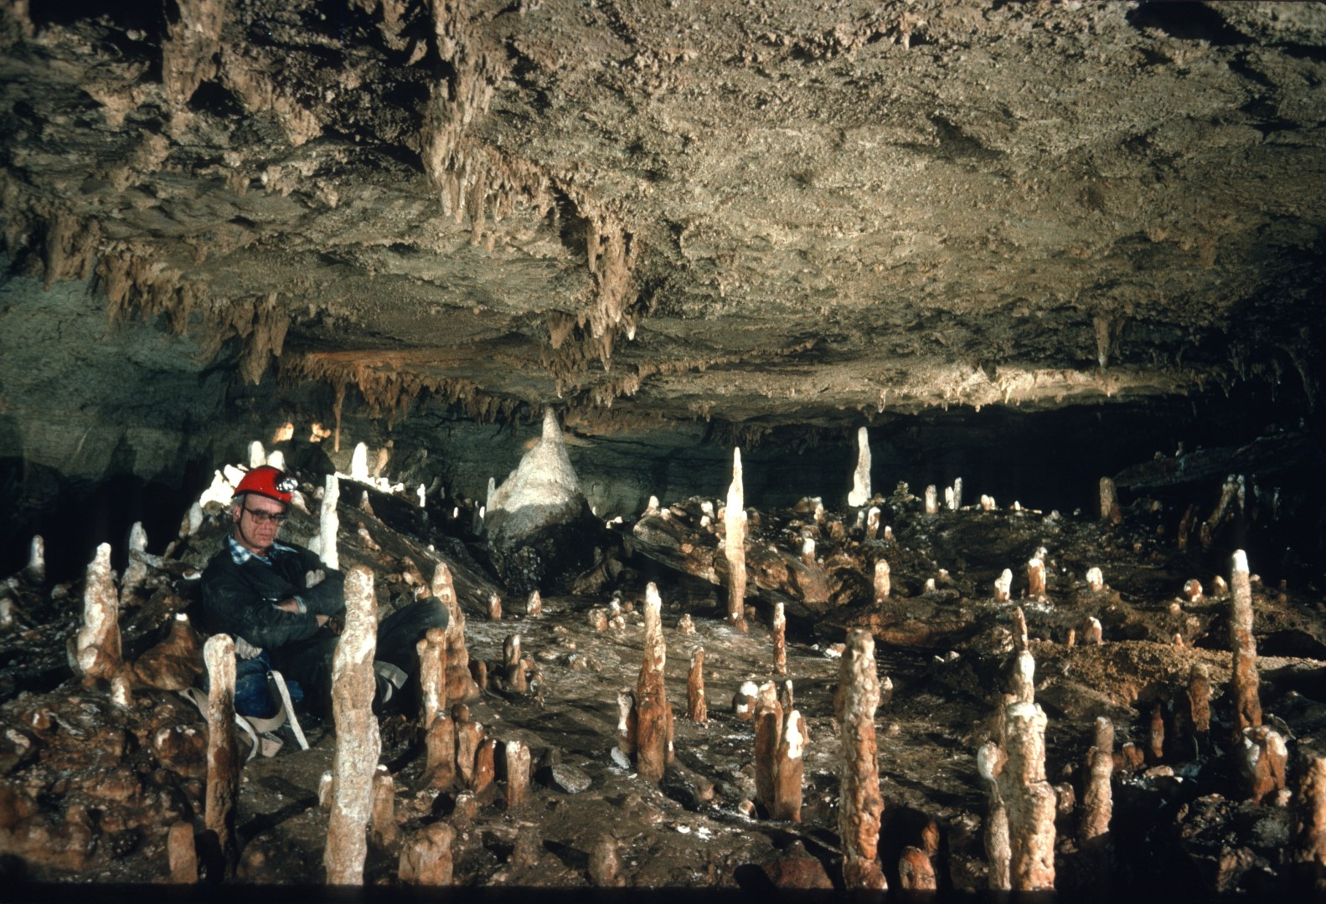
Notes:
Virtually every lead that was checked, went.

Slide 27
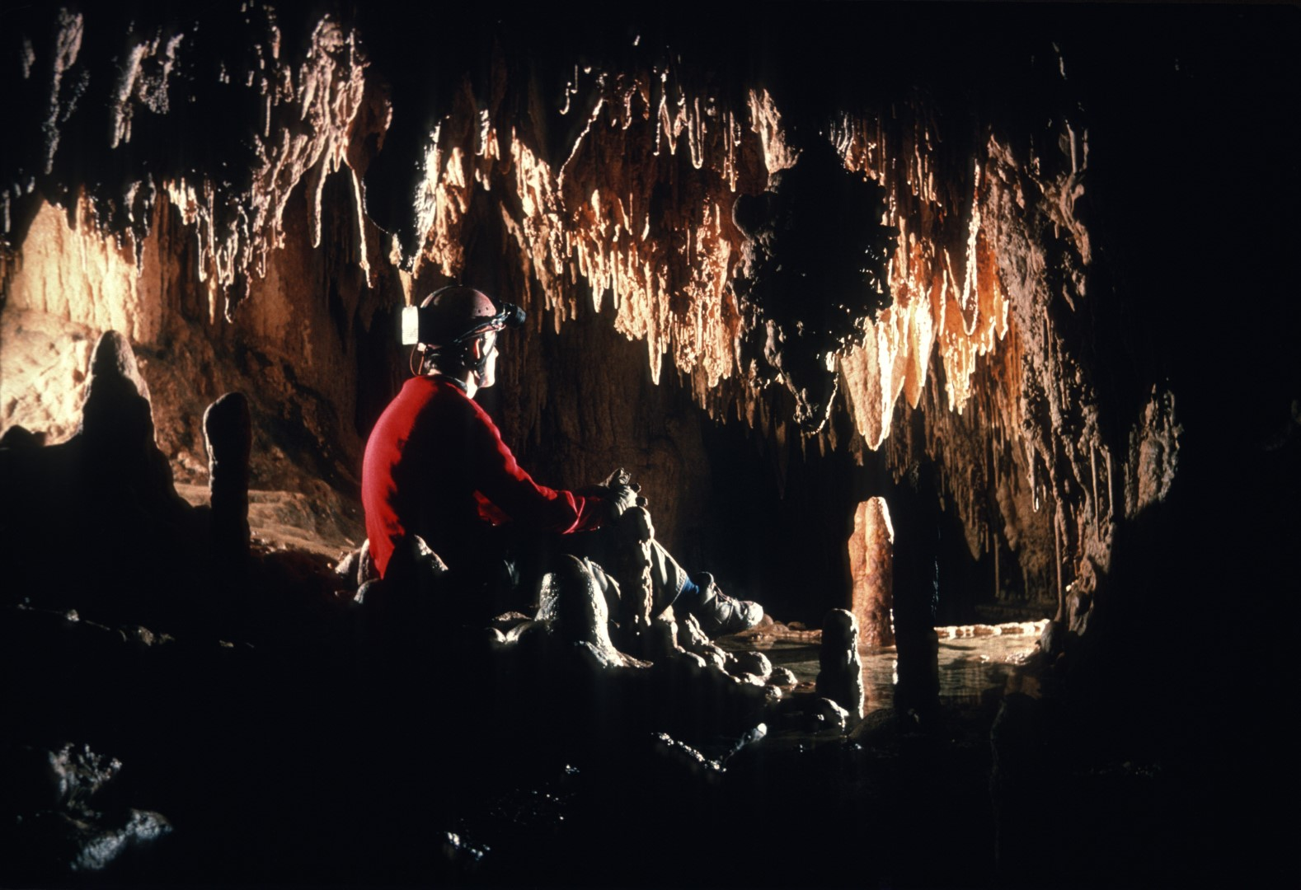
Notes:
Numerous alcoves, each with its own pristine beauty, were bypassed In the fever to push the cave to its limits.

Slide 28
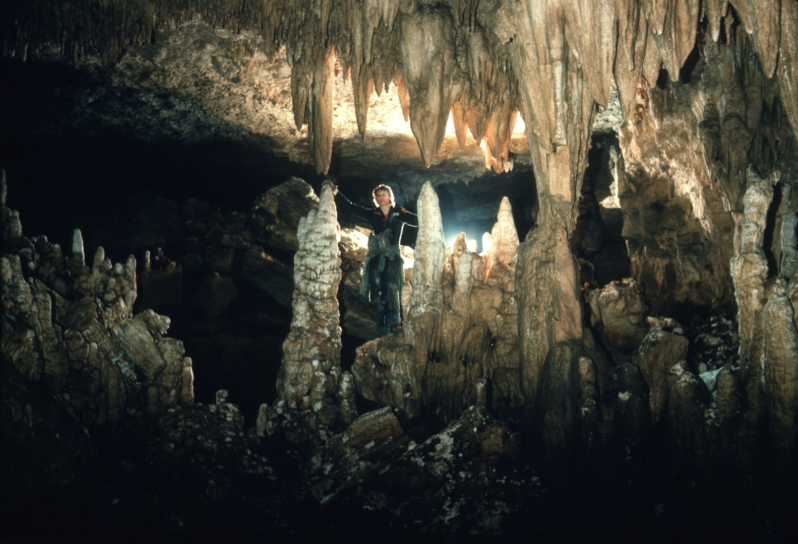
Notes:
The mapping efforts were split into two teams. One was headed by Bill Torode. The other by Don Myrick.

Slide 29
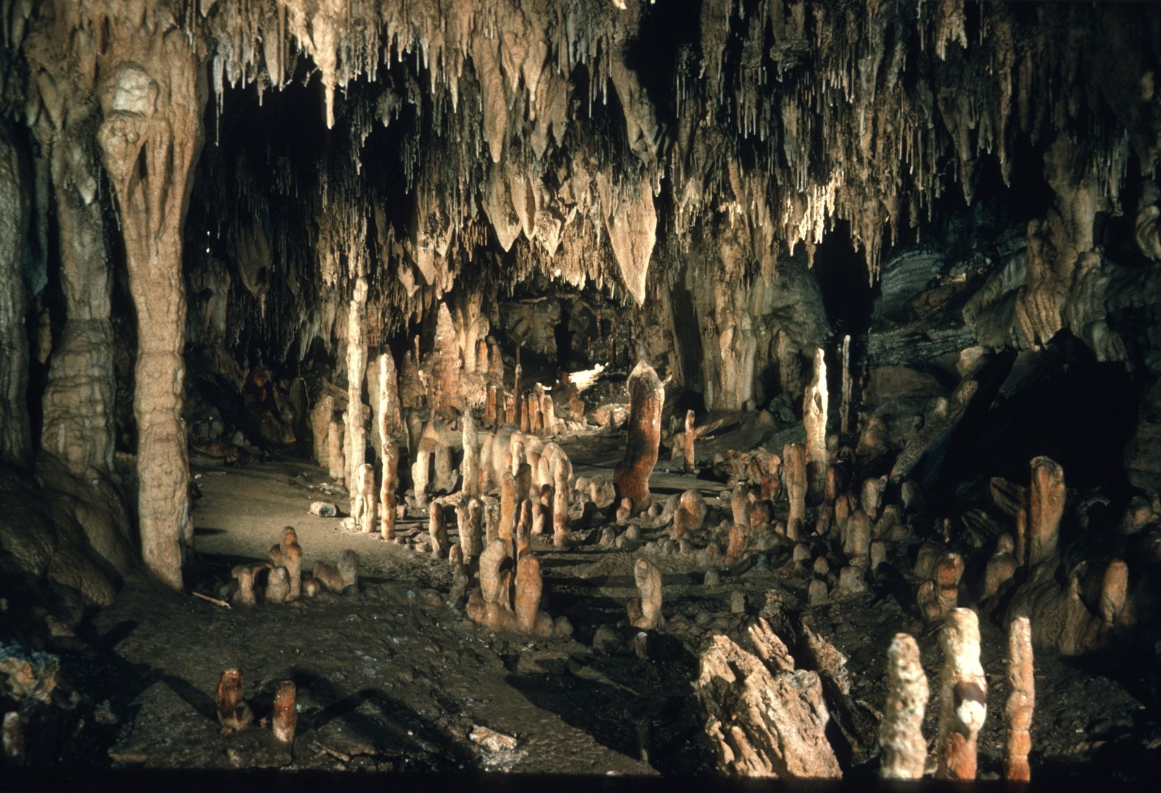
Notes:
The beautiful upper formation room, here depicted, was only an appetizer for what lay beyond.

Slide 30
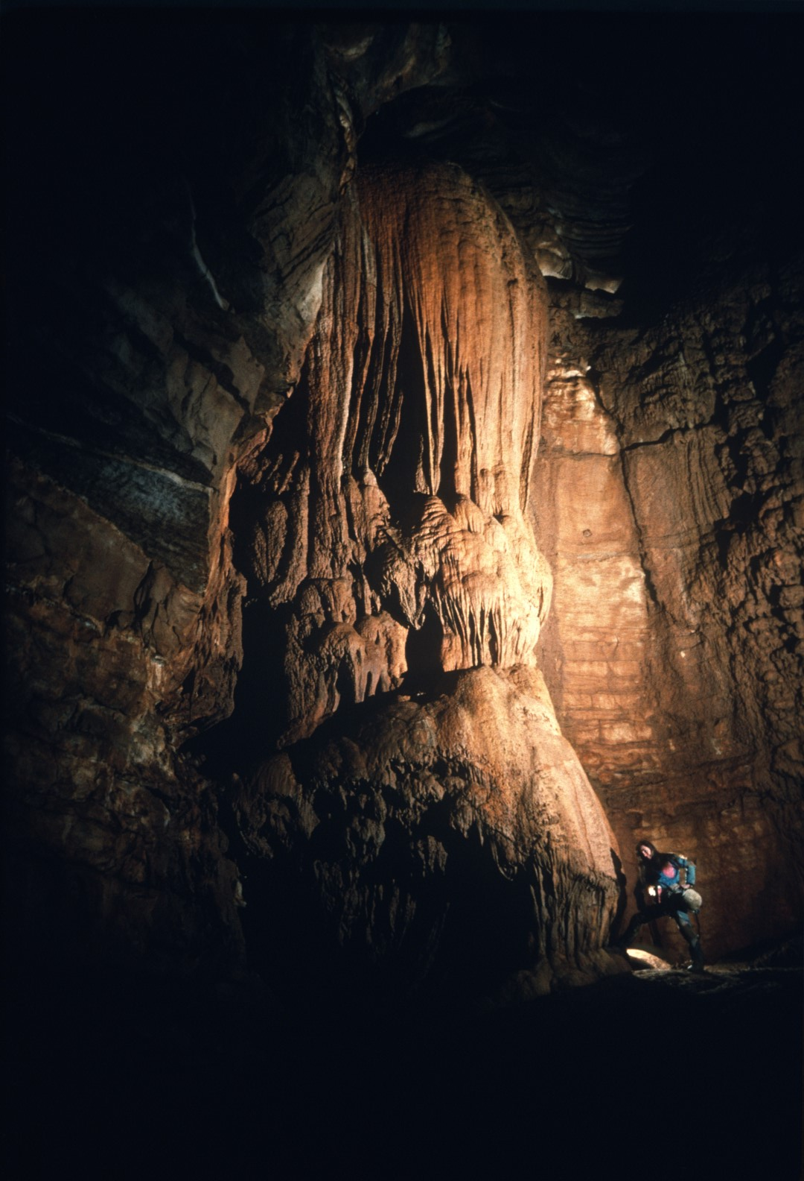
Notes:
The Elephant Ear Formation is one of the landmarks of the cave.

Slide 31
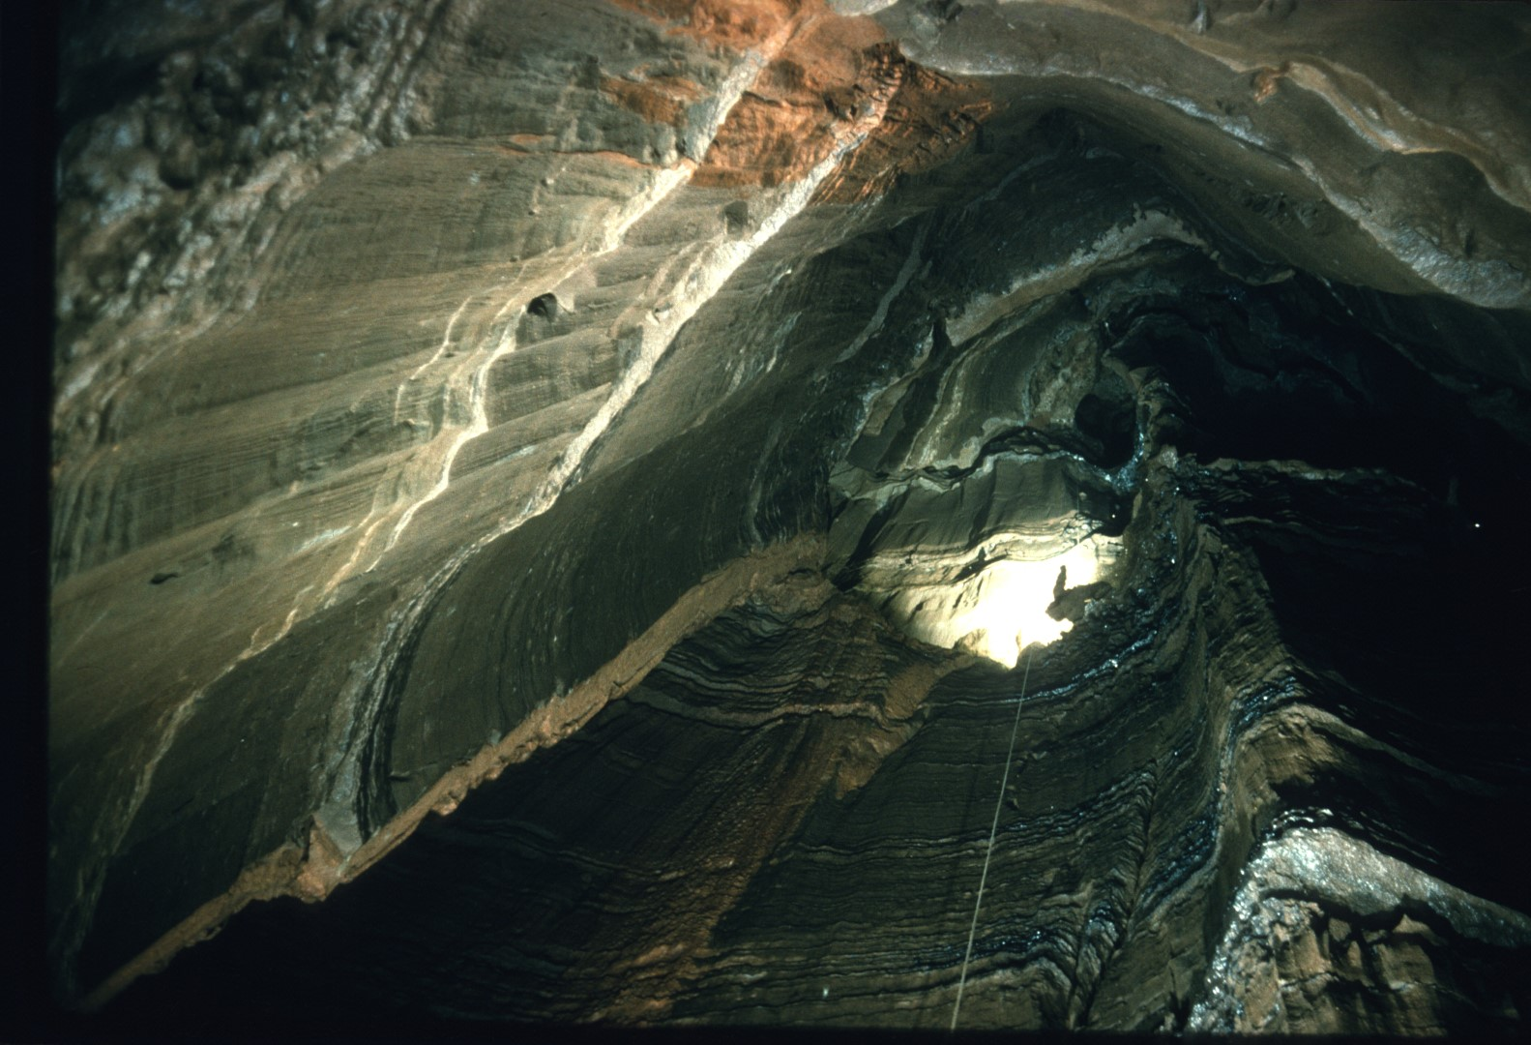
Notes:
All of the upper levels of the cave are punctuated by numerous shafts. This one Is 117 feet deep.

Slide 32
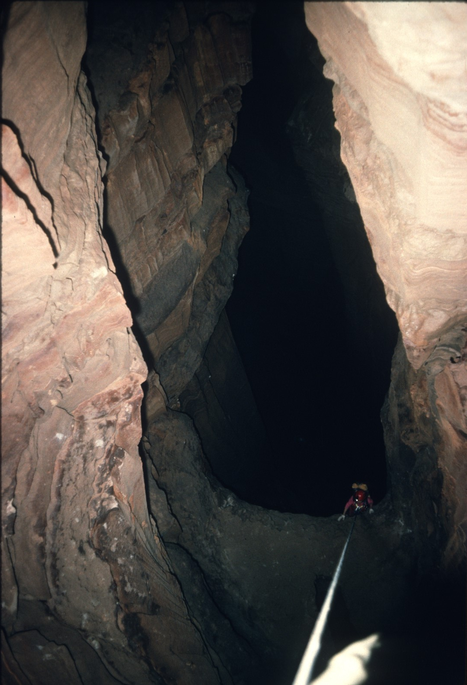
Notes:
One of the main routes through the cave runs directly over this drop.

Slide 33
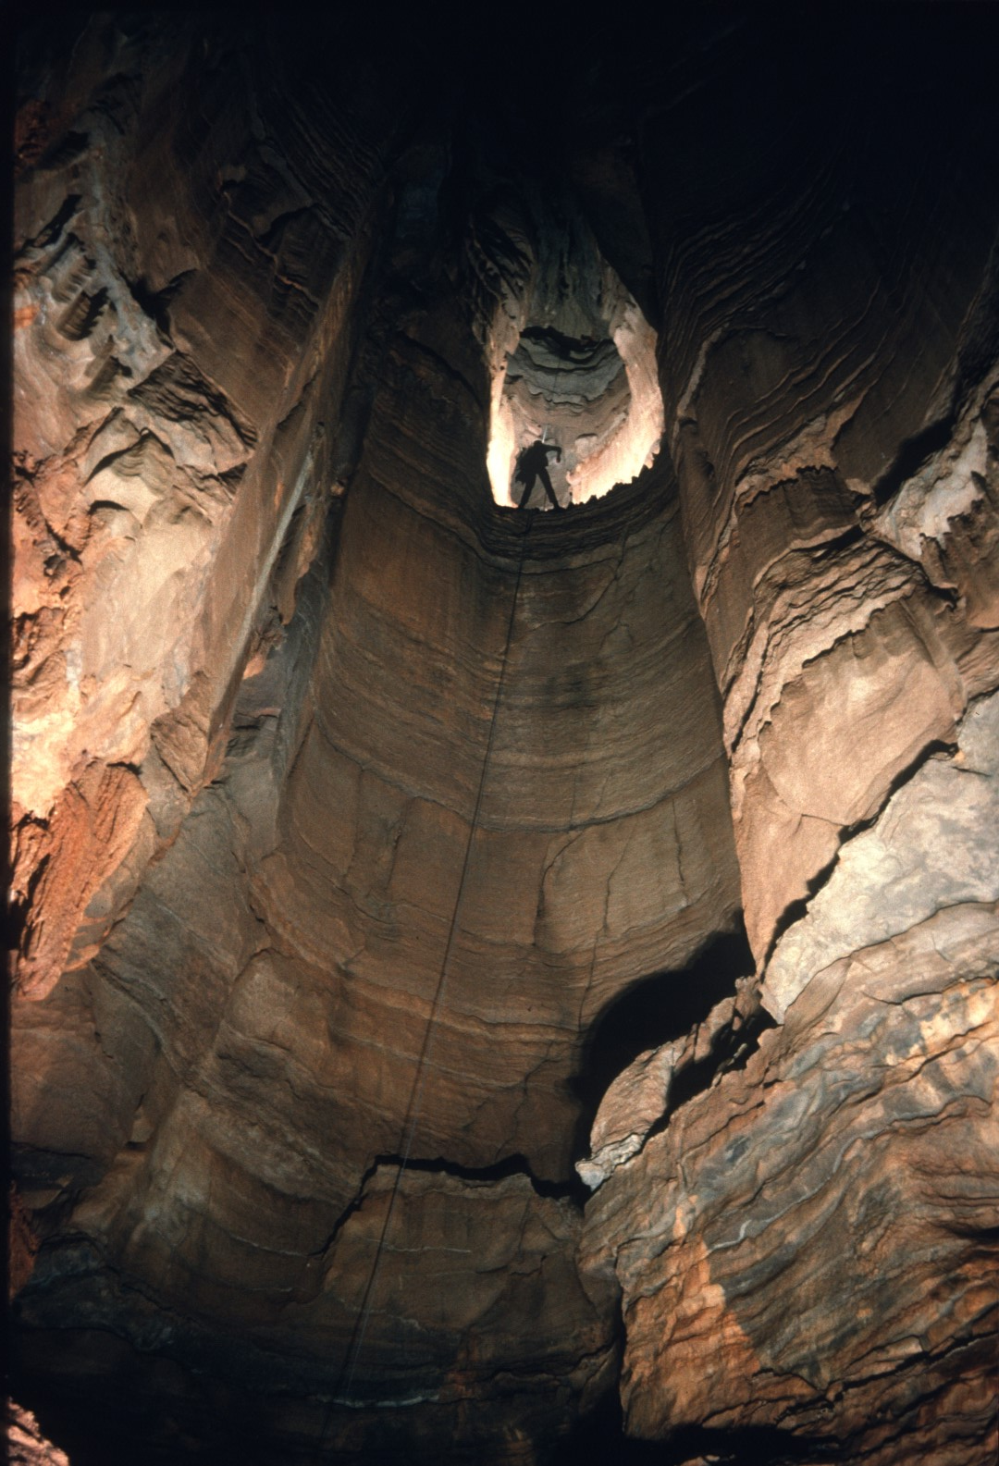
Notes:
It is the magnificent 157-foot Altoid Pit.

Slide 34
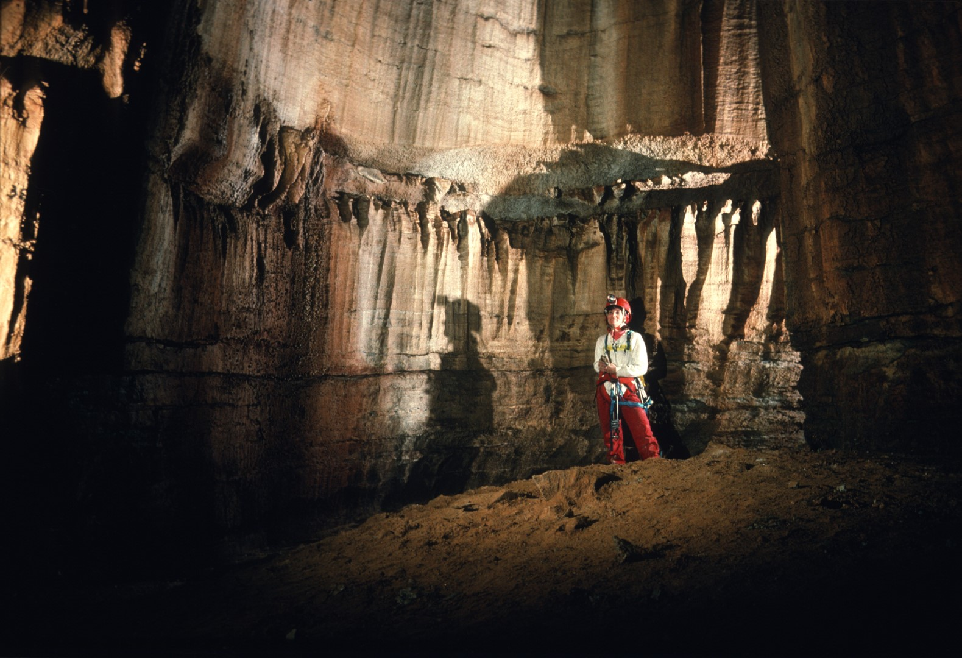
Notes:
Like almost everything else in Fern, the passage from its floor goes.

Slide 35
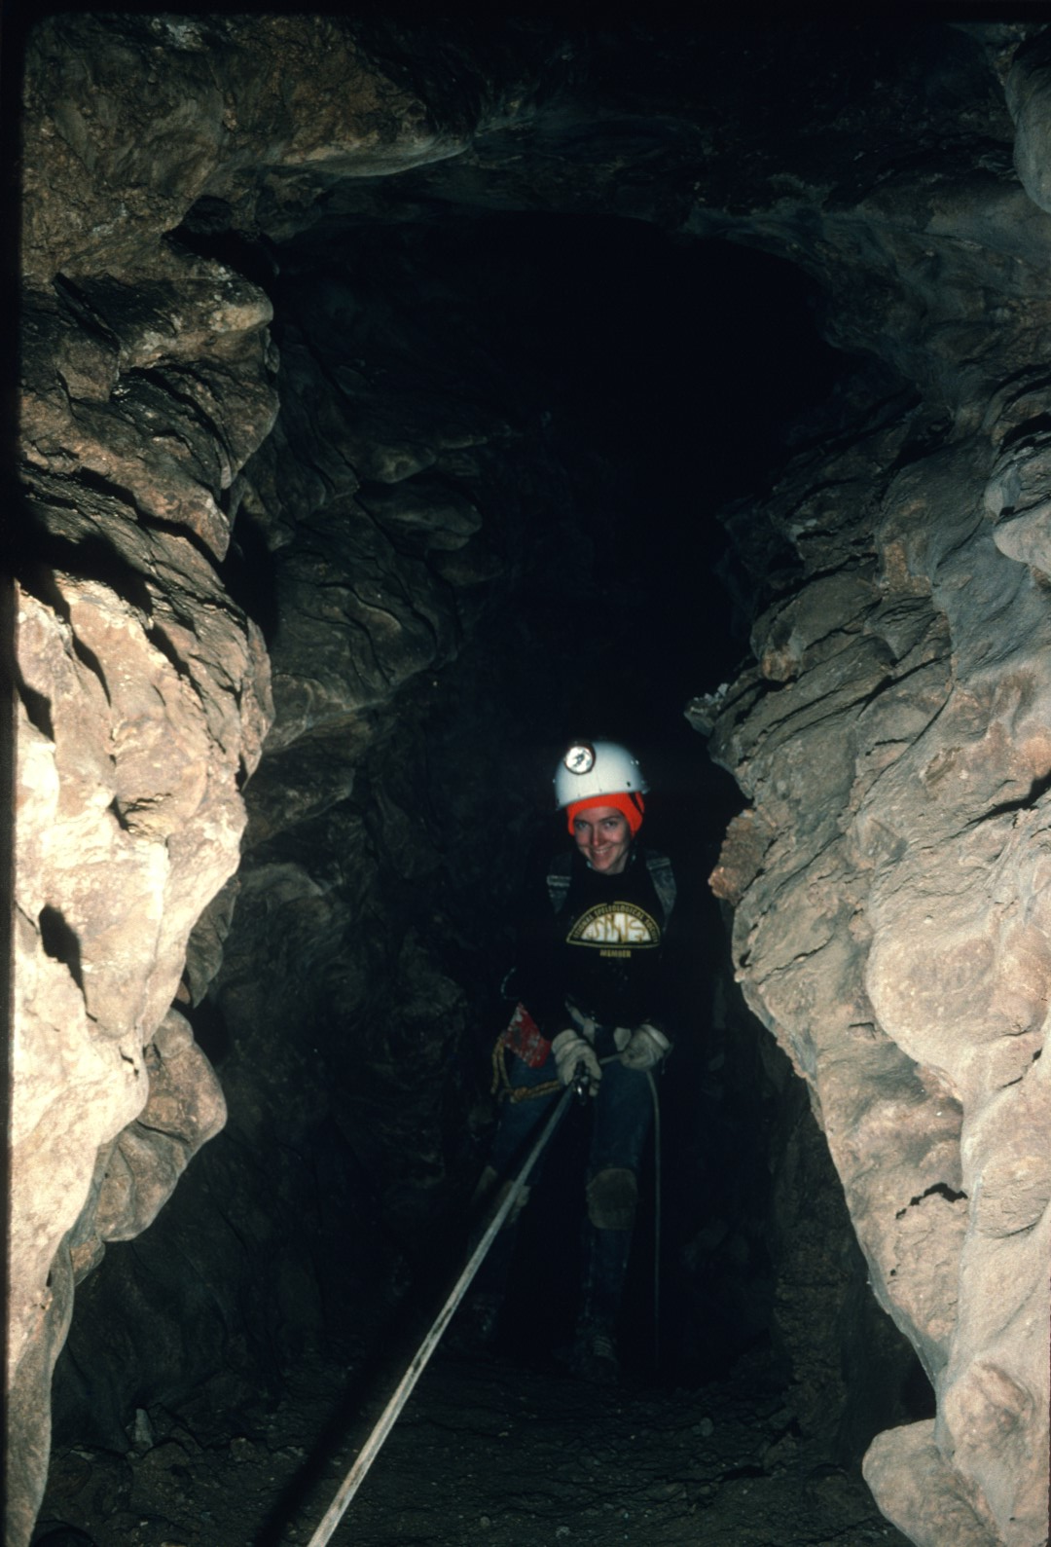
Notes:
It was quickly ascertained that Fern cave is a vast 3-dimensional labyrinth ...

Slide 36
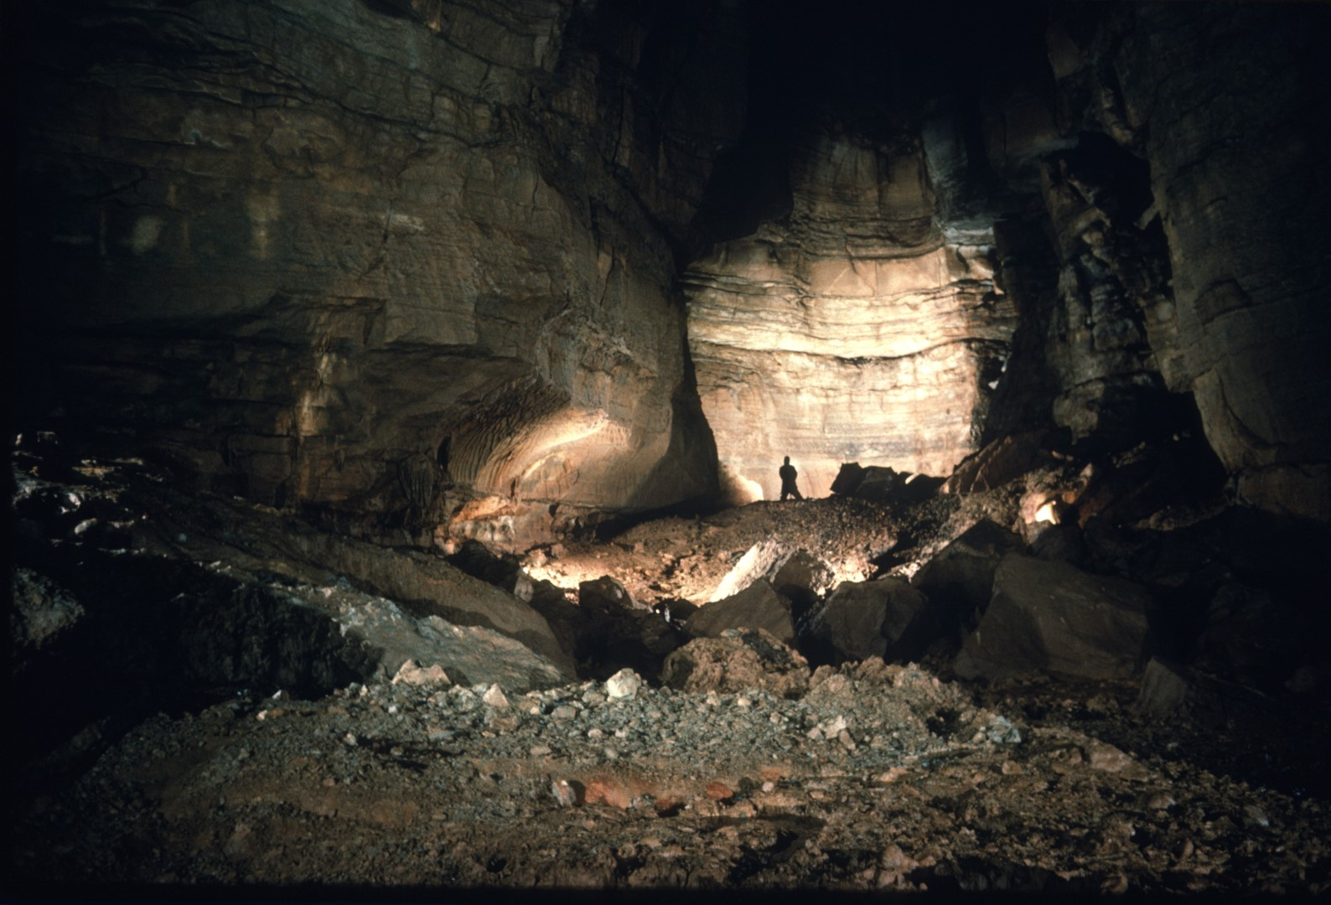
Notes:
…punctuated by deep shafts and vast rooms.

Slide 37
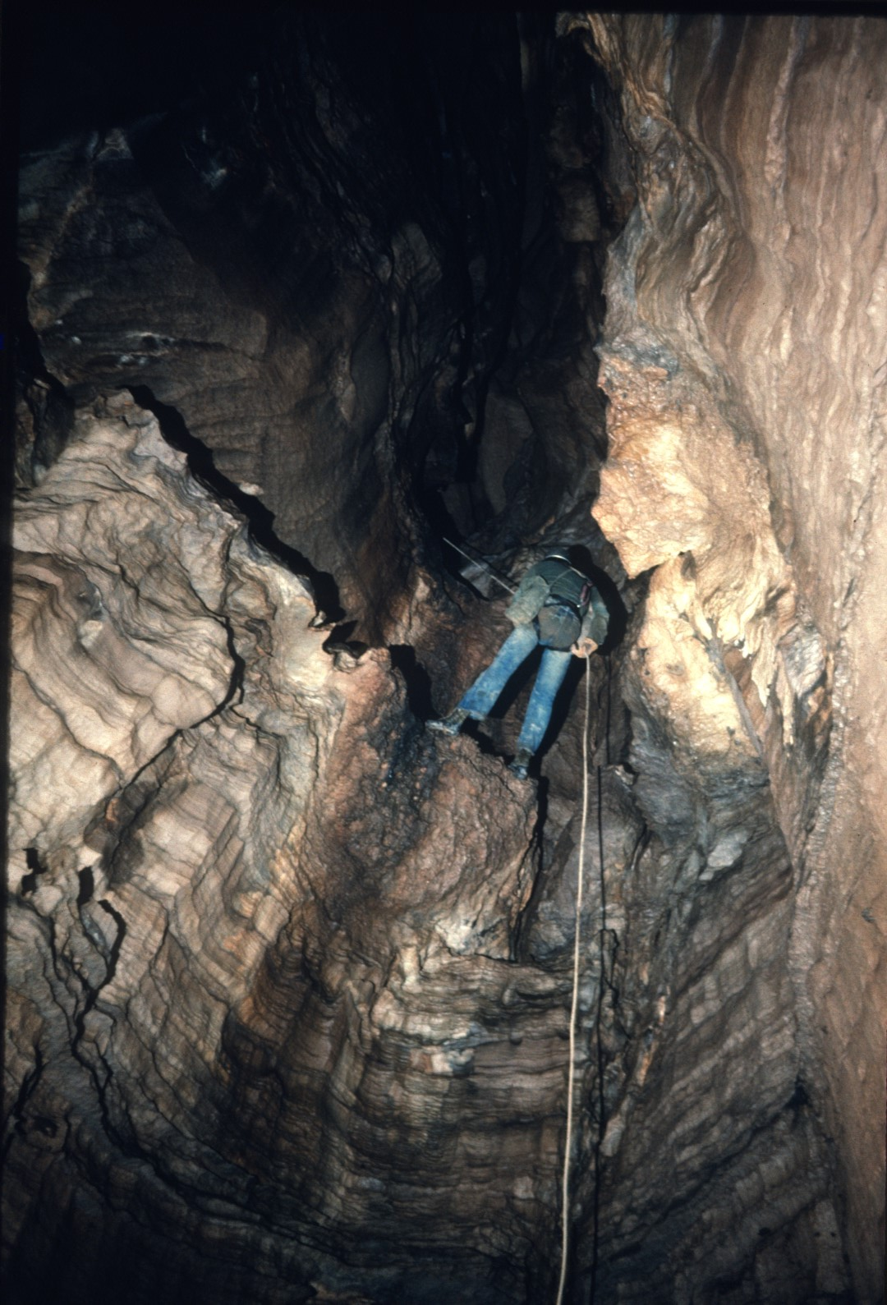
Notes:
A series of short drops leads to the middle cave.

Slide 38
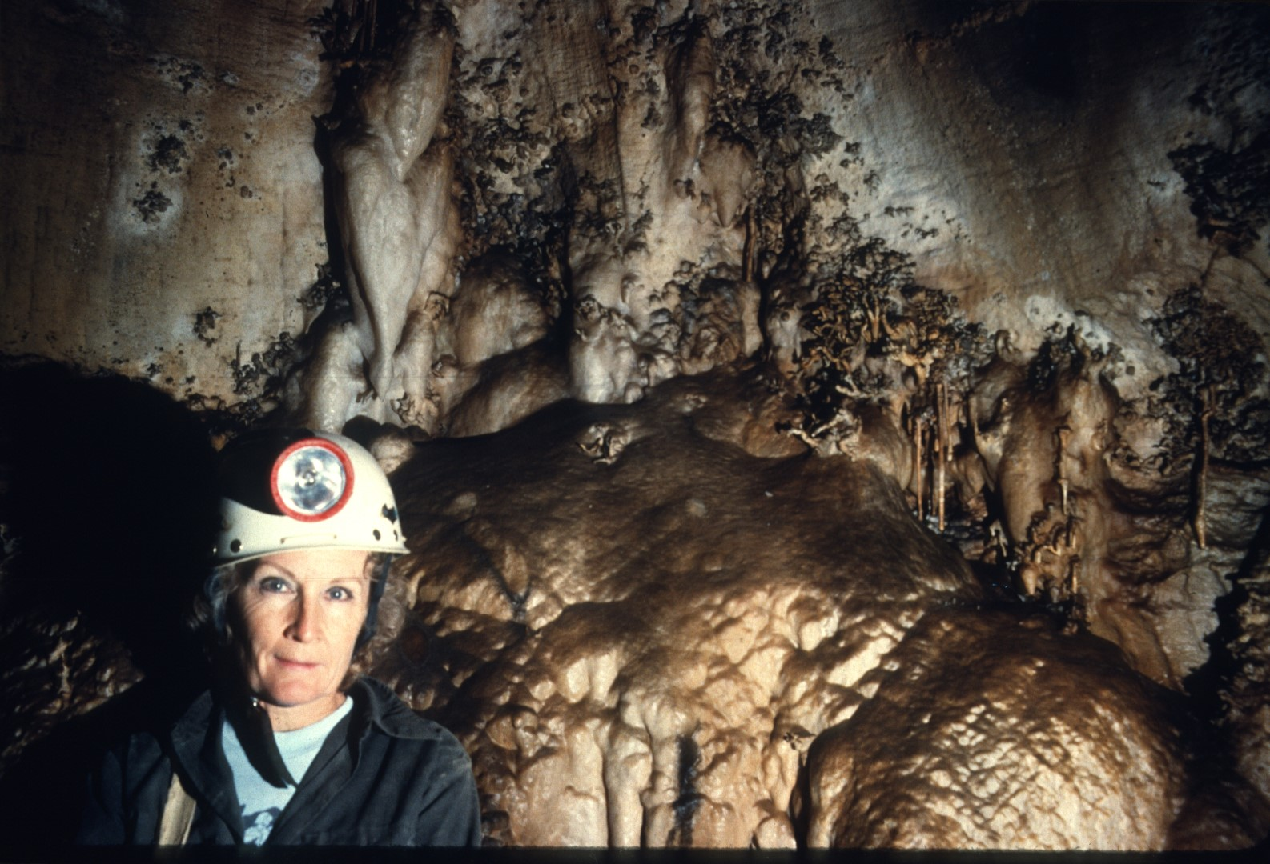
Notes:
And the cave continues unabated.

Slide 39
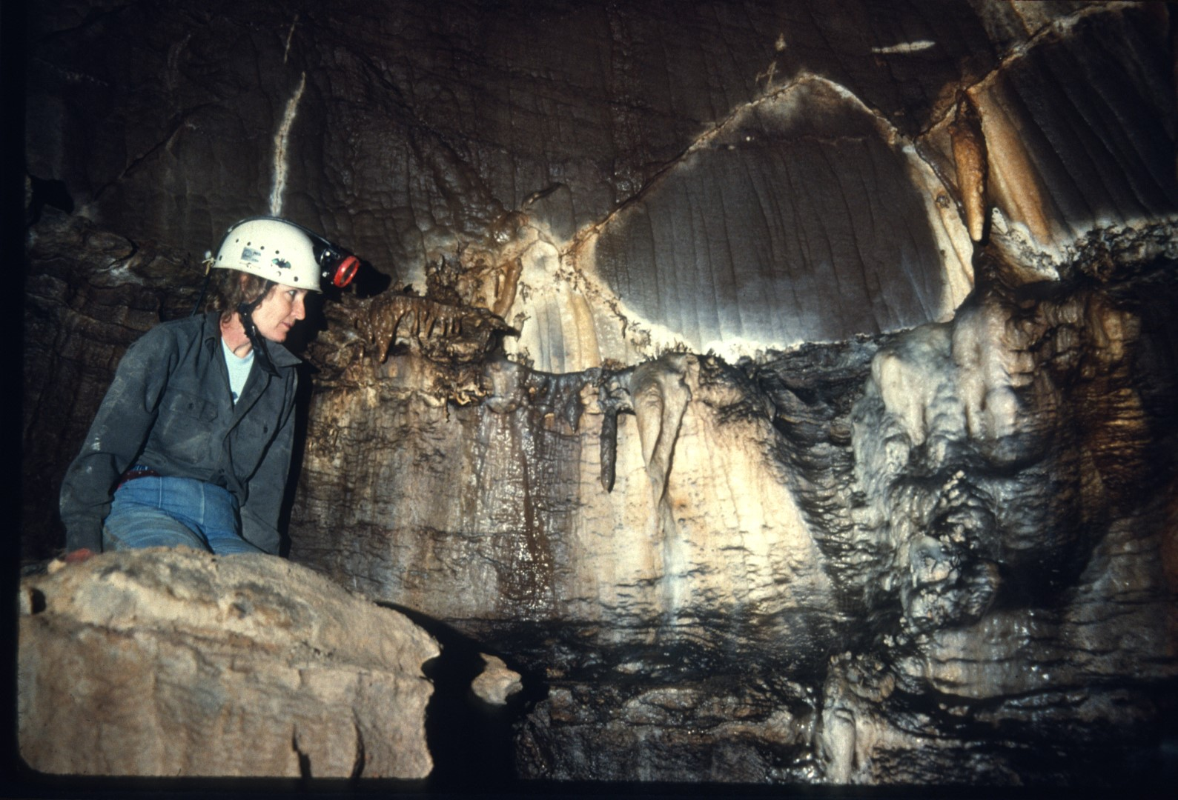
Notes:
As well as many of the formation displays.

Slide 40
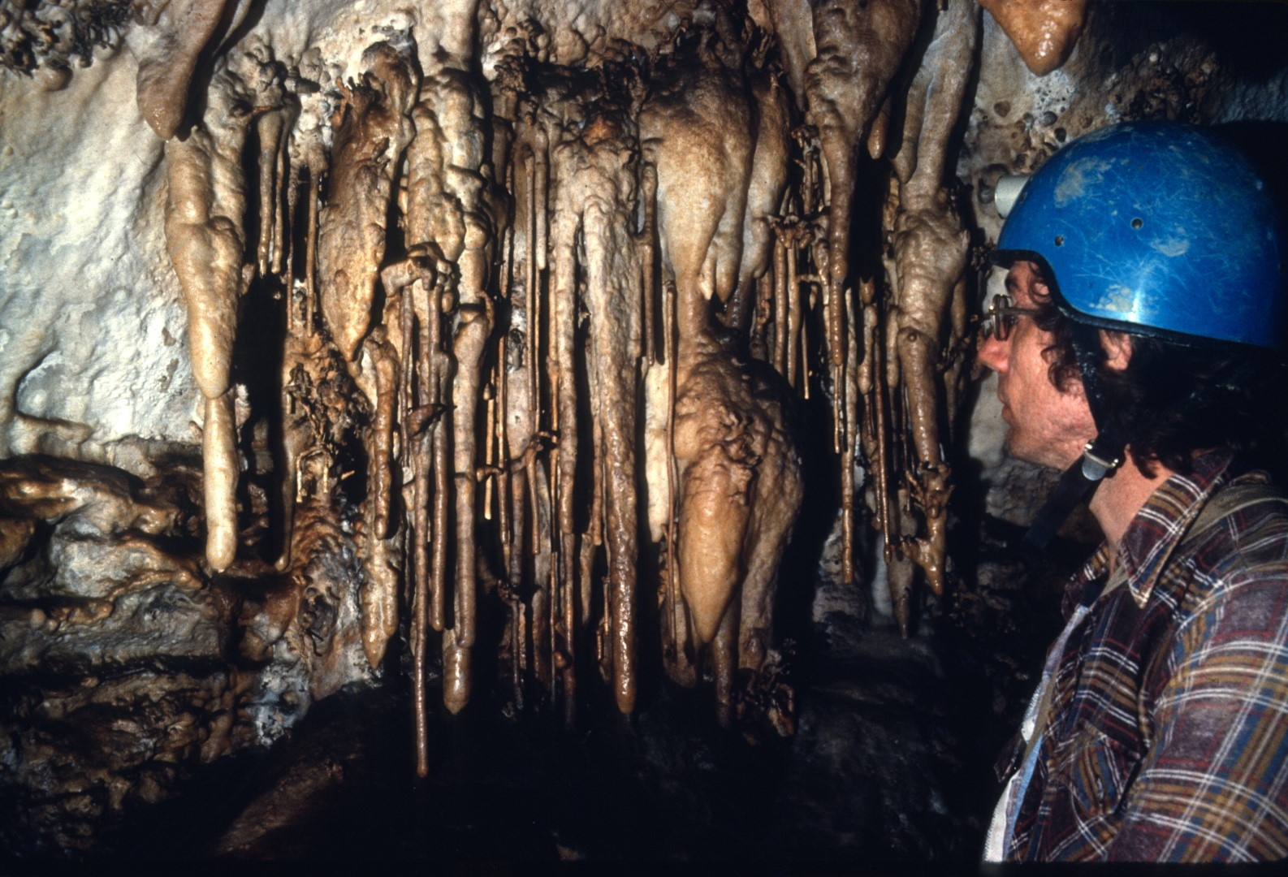
Notes:
The middle cave begins with a stream passage that runs midway between the upper entrances and the base of the mountain.

Slide 41
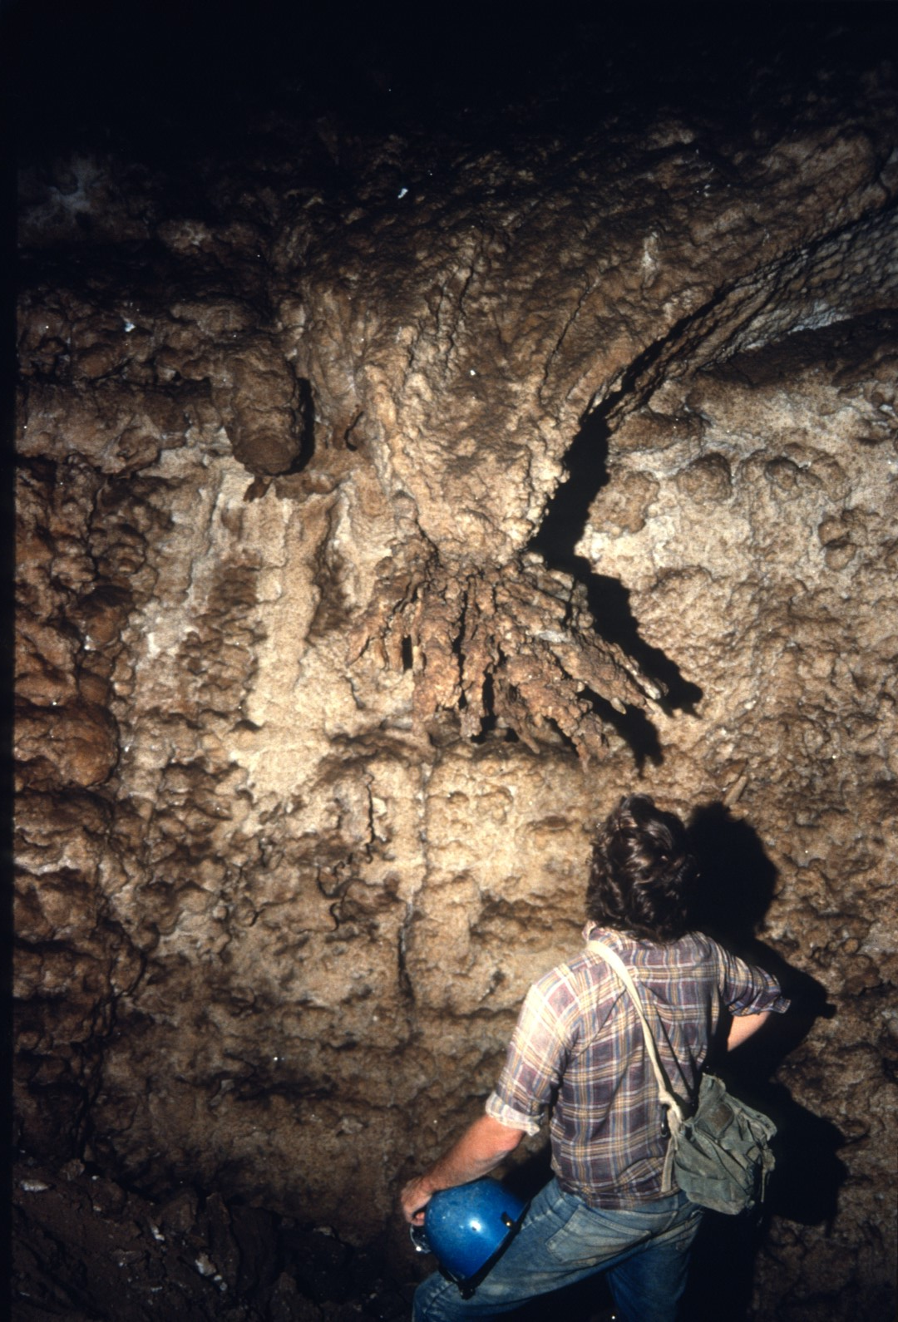
Notes:
While Bill Torode and his team mapped the upper leads ...

Slide 42
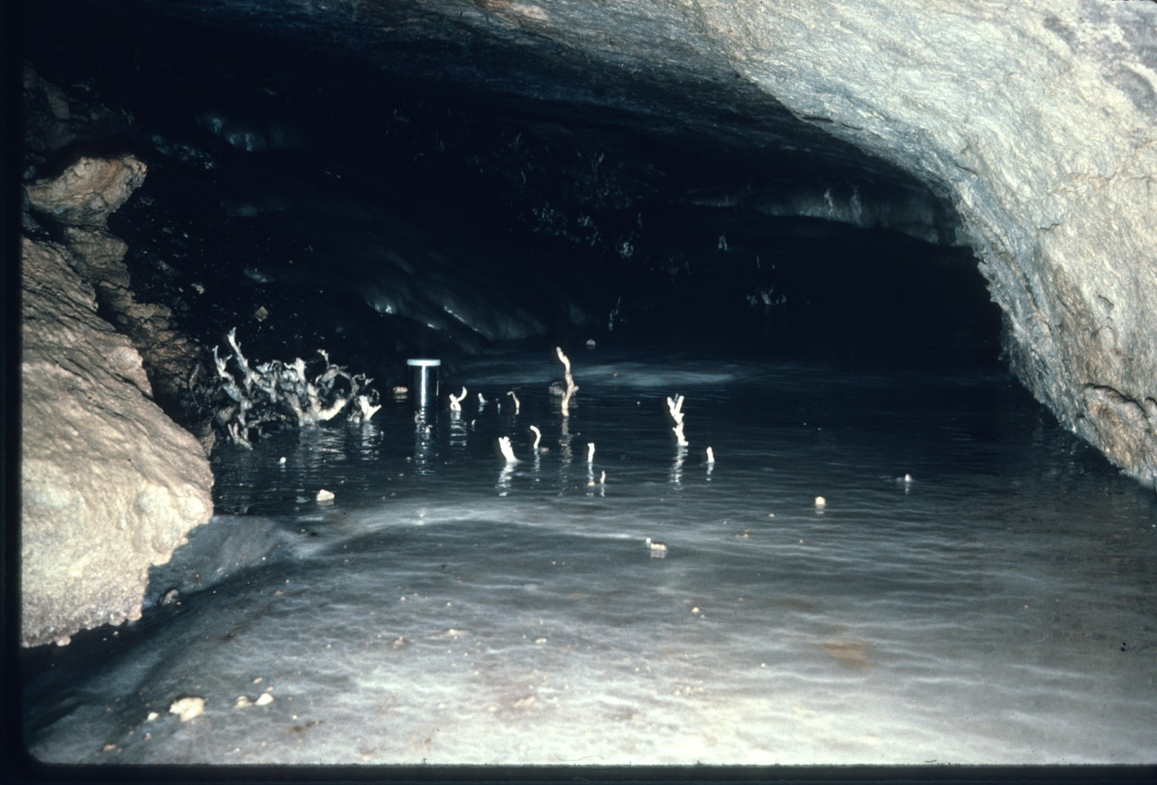
Notes:
…Don Myrick and his team mapped the Middle Cave and headed for the base of the mountain.

Slide 43
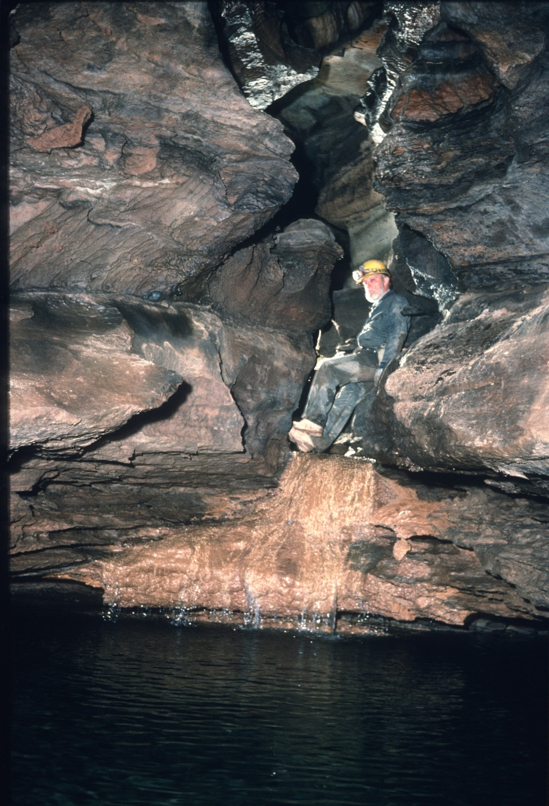
Notes:
Their trek was not without numerous side passages and surprises.

Slide 44
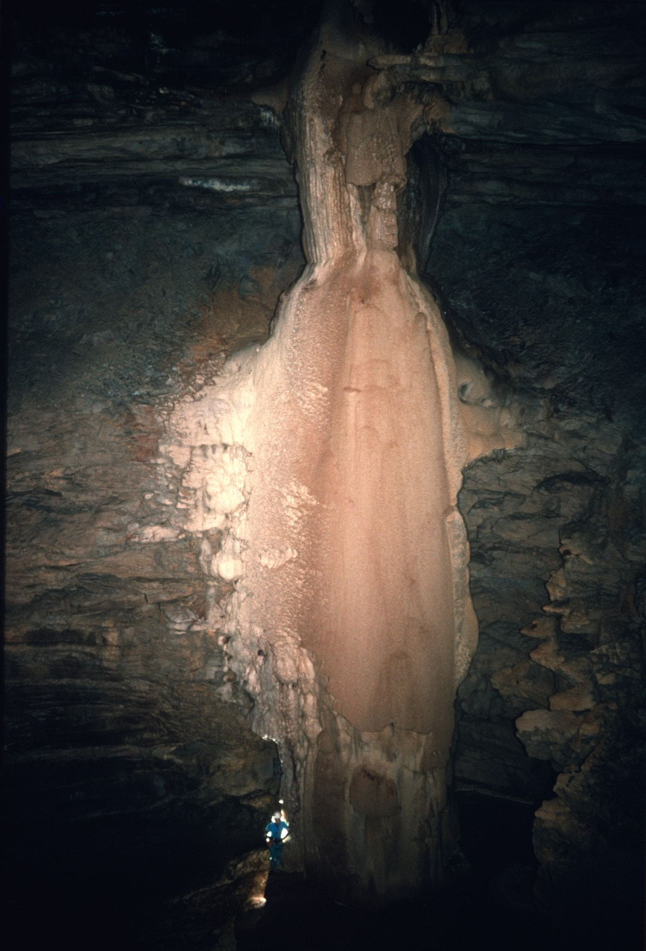
Notes:
The highlight of the Middle cave is the Balcony Room, so named because the passage Intersects this room at a balcony near its ceiling. The formation plastered to the opposite wall is 80 feet high. The lead at the top has been checked.

Slide 45
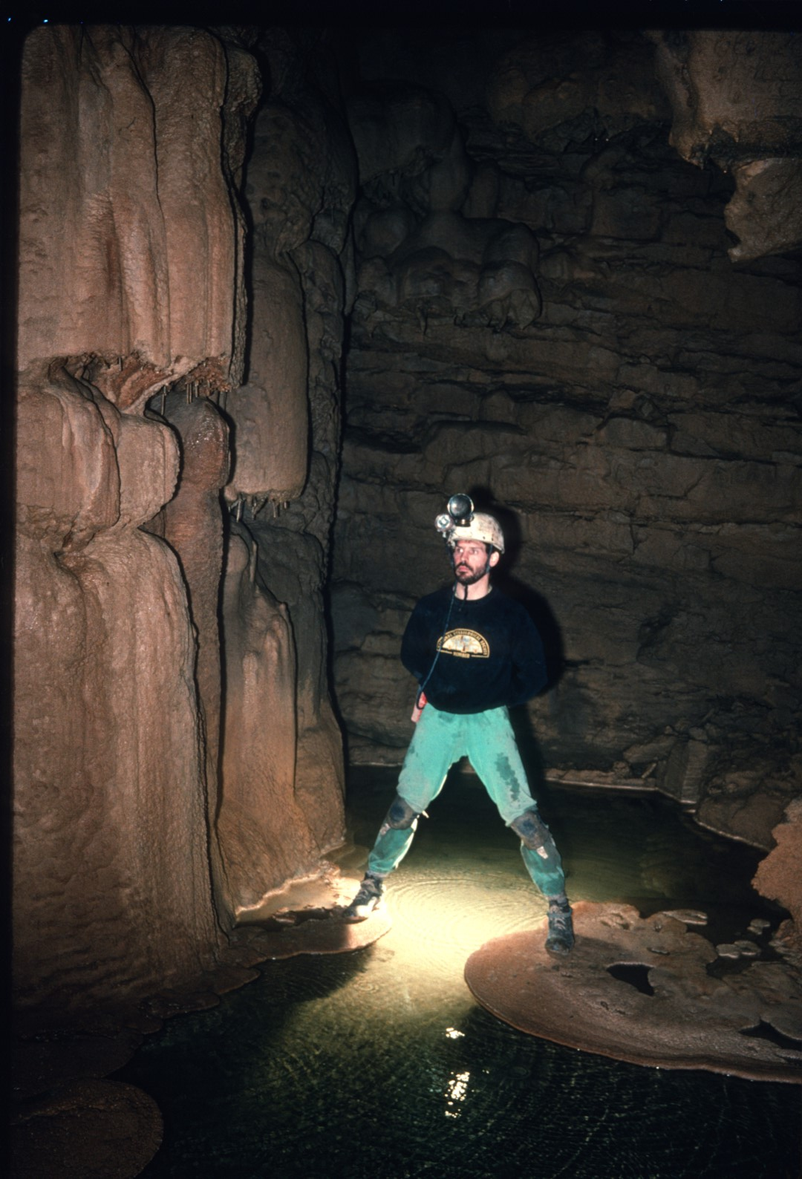
Notes:
While a tricky climbdown does exist to reach the floor, ...

Slide 46
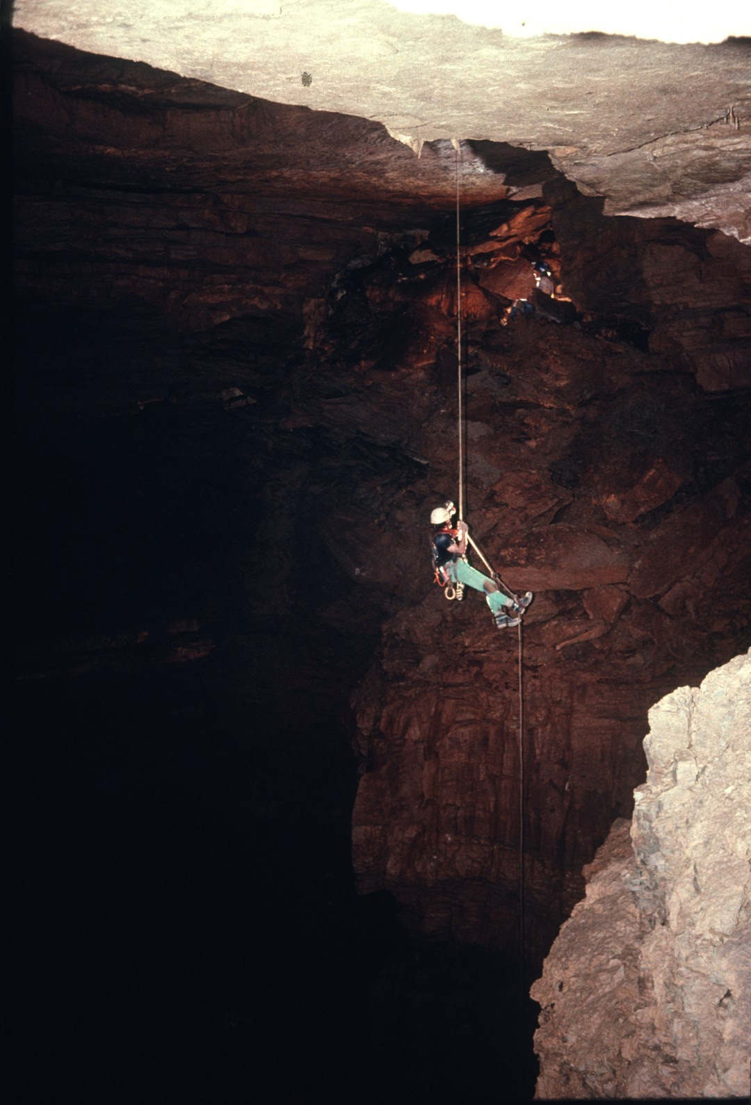
Notes:
…it is far more fun to rig an 80-foot drop into the room.

Slide 47
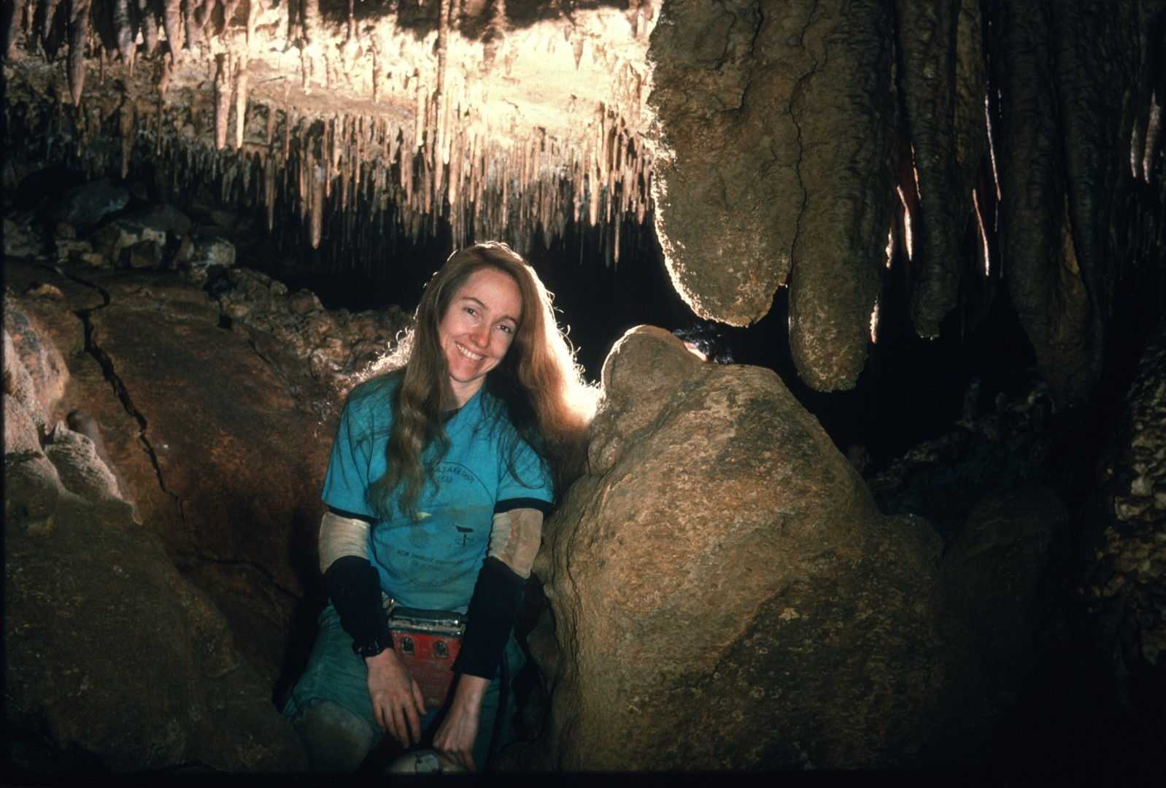
Notes:
For those who really know the cave, the Balcony room was aptly named. It has three different balconies adjoining it.

Slide 48
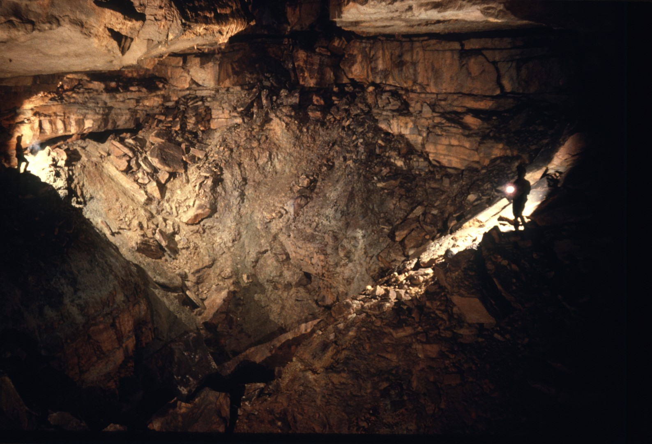
Notes:
The middle cave formally ends in the vast West Room. But the cave continues. Through a series of drops out of this room, Don Myrick and his team reached the Lower Cave. Meanwhile ...

Slide 49
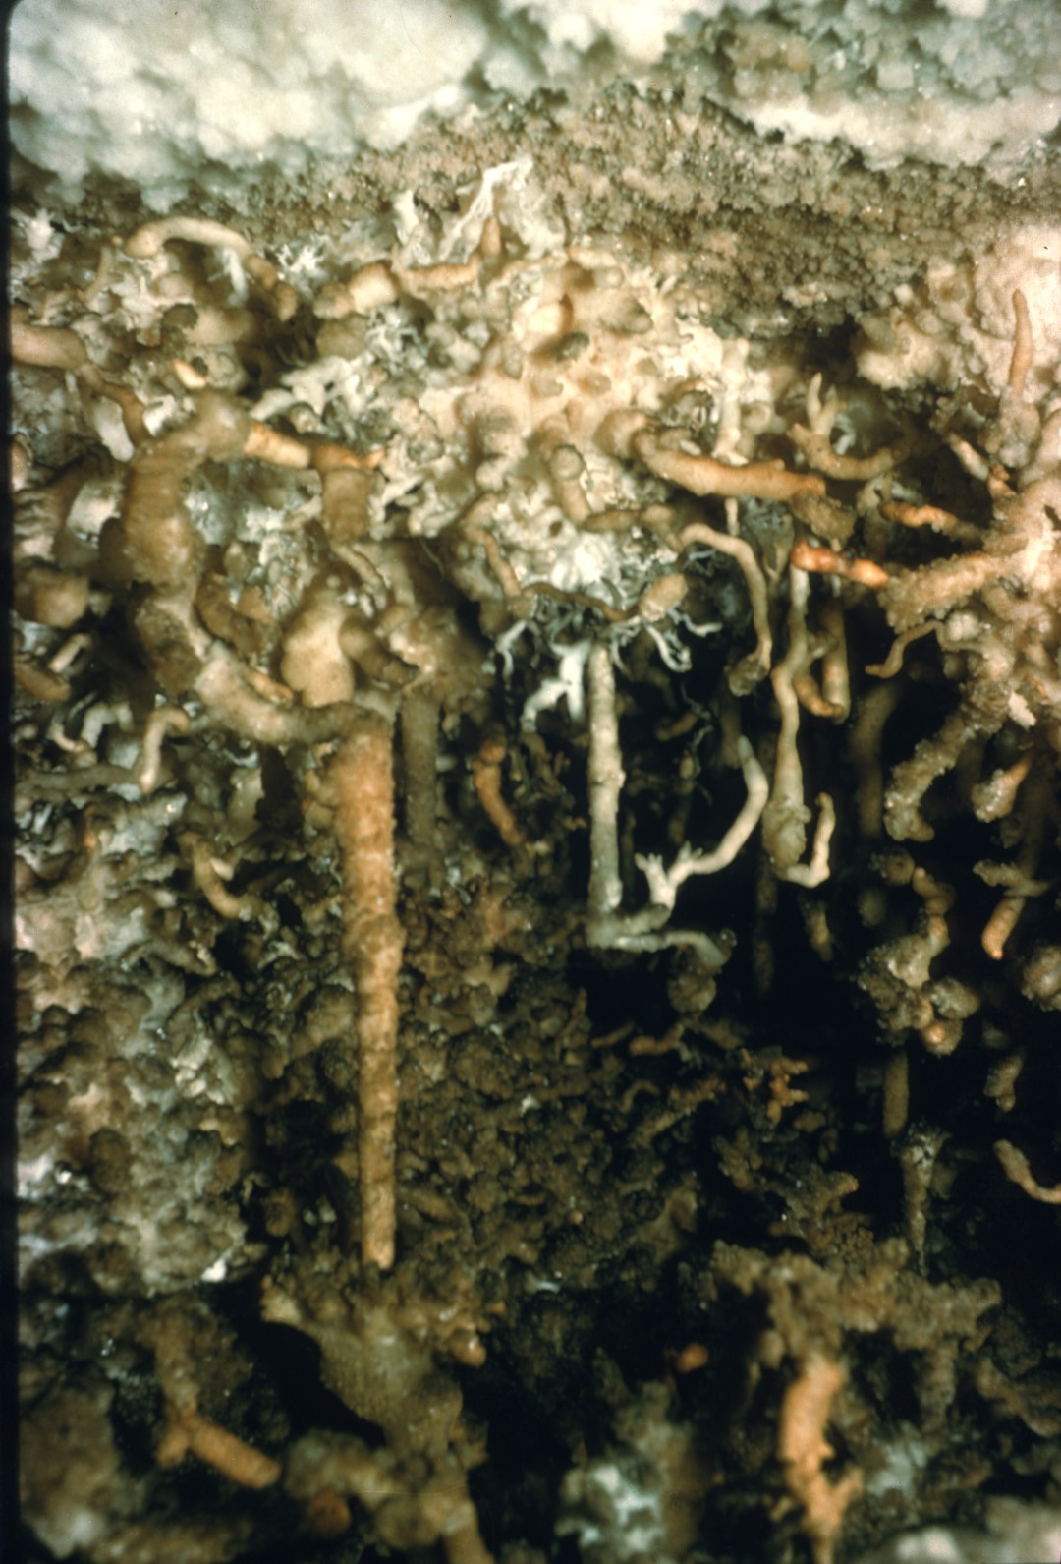
Notes:
Bill Torode and John French discovered a Heaven of Helictites in one of the upper levels.

Slide 50
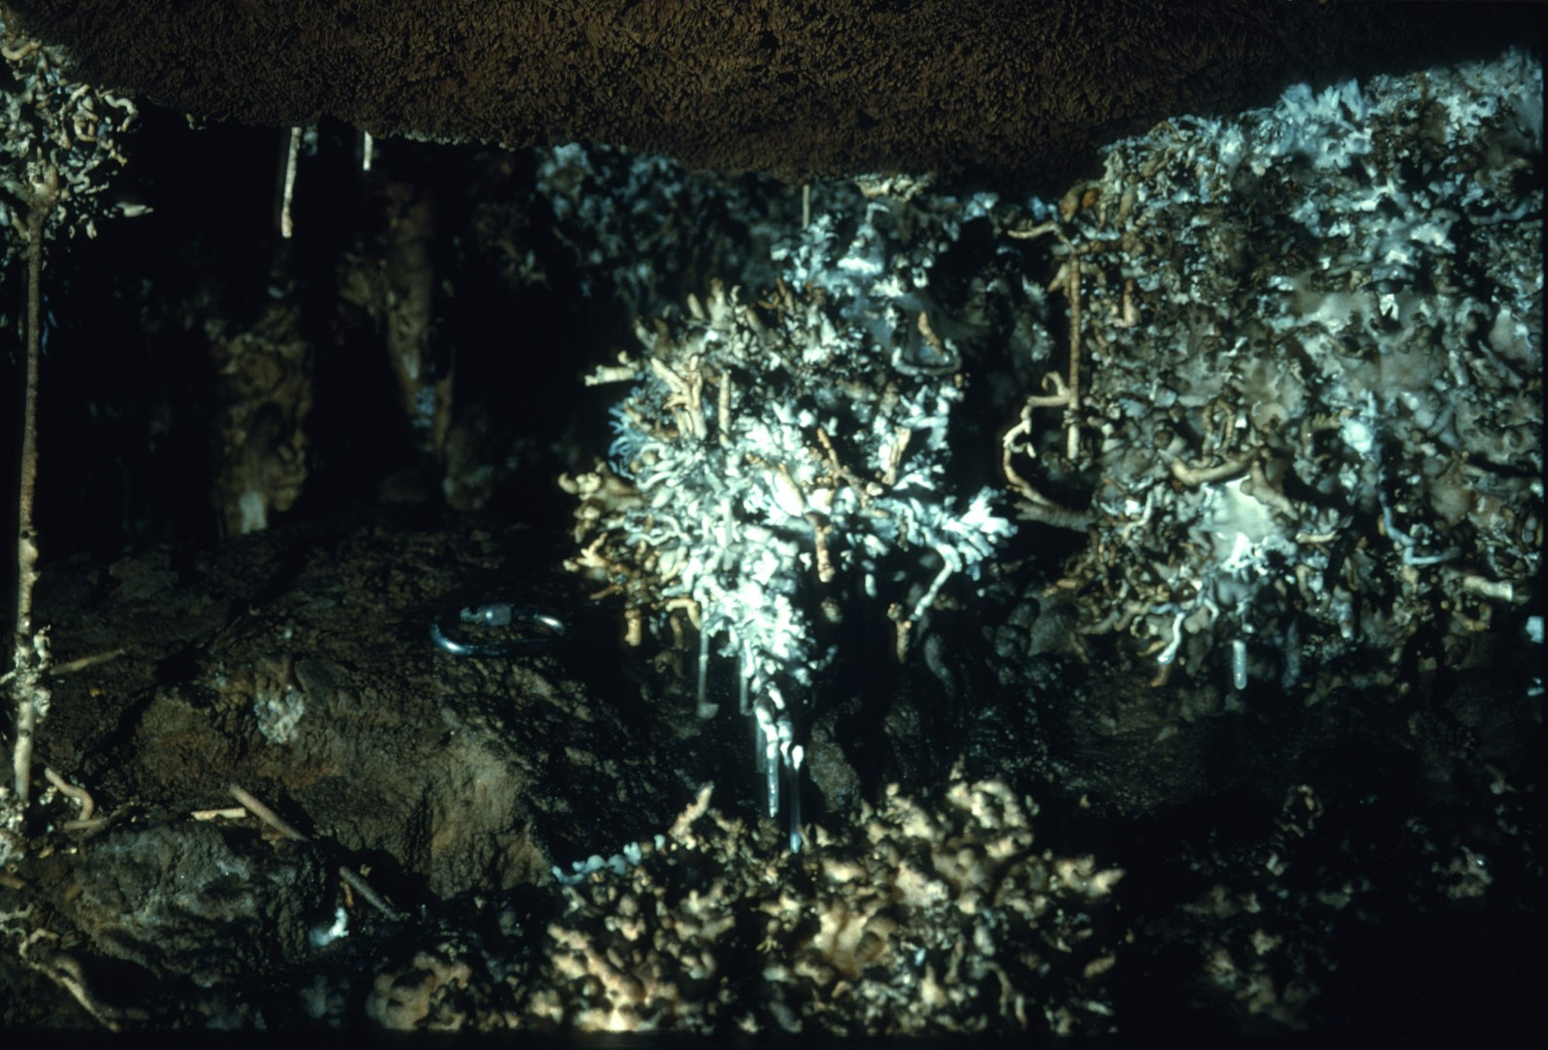
Notes:
Some of the bushes are over 18 inches in height.

Slide 51
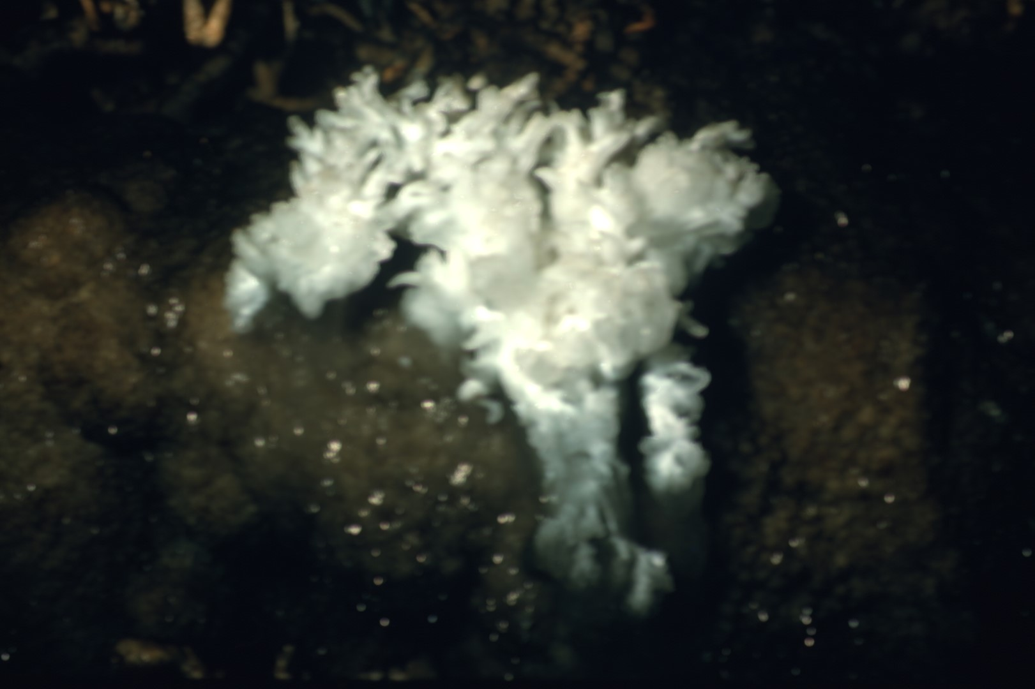
Notes:
Others are small and delicate.

Slide 52
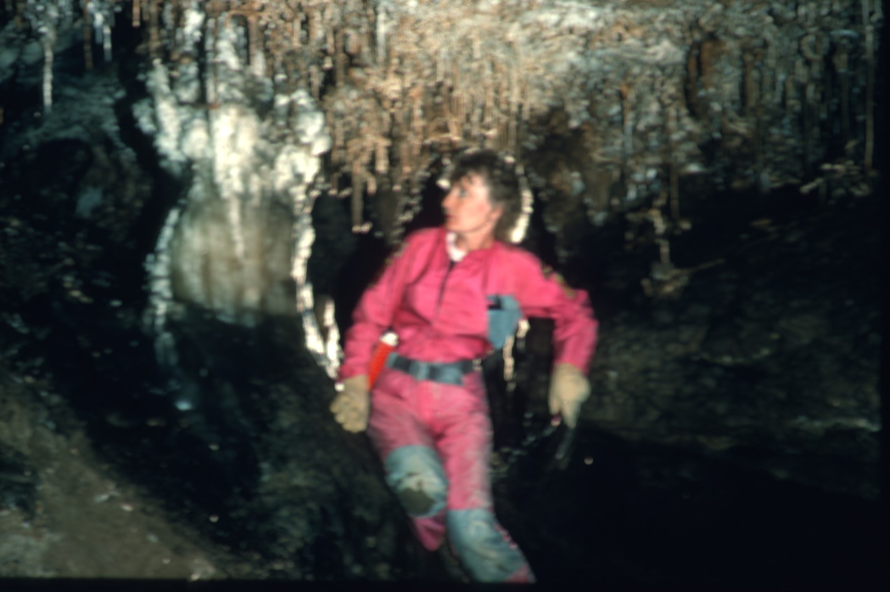
Notes:
The entire Helictite Heaven area has been designated as a helmets off area. This gives the helictites a fighting chance.

Slide 53
Notes:
There are also numerous examples of mlcro-helictites. This entire scene is less than 5 inches across.

Slide 56
Notes:
The North Cave forms an appendix to the entire cave system.

Slide 57
Notes:
It could comprise a complete cave system in itself.

Slide 58
Notes:
To give some idea of the complexity of Fern Cave, it can be stated that the North Cave has 7 distinct levels spread out over 150 feet in elevation.

Slide 59
Notes:
The entire cave system is spread out over about 530 feet in elevation and many more levels.

Slide 60
Notes:
A pristine beauty can be found in some of the obscure levels.

Slide 61
Notes:
This photograph was taken in virgin cave.

Slide 63
Notes:
Access down through the morgue entrance leads to a totally different type of cave.

Slide 64
Notes:
In winter months, it is a hibernaculum for hundreds of thousands of bats. During these times, entry into this area of the cave is strictly forbidden.

Slide 65
Notes:
Large sections of the morgue are copiously decorated with bat guano.

Slide 66
Notes:
Massive breakdown rooms are frequently encountered.

Slide 67
Notes:
It has been said that the Morgue Cave is so bleak and barren that it is beautiful.

Slide 68
Notes:
As with everywhere else in Fern, it has shafts.

Slide 69
Notes:
This is the normal condition of the sump entrance to Fern Cave.

Slide 70
Notes:
For perhaps a few months during the driest time of the year, this area becomes accessible.

Slide 71
Notes:
After about 1,000 feet, the passage terminates in a real sump.

Slide 72
Notes:
In 1978, a dive team entered the lower sump entrance and proceeded to the sump at the end of the passage.

Slide 73
Notes:
At the same time, a regular caving team worked its way from an upper entrance down through the mountain to a known sump in the Lower Cave.

Slide 74
Notes:
The result was the Champagne connection. Yes, we are toasting with real Champagne. On the left is Bob Millot and Joe Dabbs is in the center. The innocuous fellow on the right is the producer/photographer of this series.

Slide 75
Notes:
The sump room in the Lower Cave is a very unusual place. The cool air pressure from the rest of the cave forces its way through the sump. The result is an almost continuous reverberation of very unusual sounds. The waters literally speak.

Slide 76
Notes:
The Lower Cave in Fern is without a doubt the most pristine area of the cave. It is certainly the most remote.

Slide 77
Notes:
Its several miles are filled with broad avenues ...

Slide 78
Notes:
…and spacious rooms.

Slide 80
Notes:
Between the years 1969 and 1971, the cave was two distinct cave systems.

Slide 81
Notes:
There was the Fern System and the cave around Surprise Pit.

Slide 82
Notes:
In 1971, the two systems were connected by Don Myrick, Sherry Graham, and Dick Graham.

Slide 83
Notes:
The connection was made from the lower cave.

Slide 85
Notes:
A modern connection. A joint American and USSR team splits up in the cave and rejoins In the Middle Cave. This team is from Ukraine. As we all know, only months later the USSR was no more.

Slide 86
Notes:
Fern Cave is currently in the process of being totally remapped by 'the Fern Cave Project. The highest standards are being used.

Slide 87
Notes:
But the efforts of Bill Torode (shown here) and Don Myrick are by no means forgotten. The achievements of the Fern Cave Project are built upon these predecessors.

Slide 88
Notes:
Fern Cave is owned by the Wheeler Wildlife National Refuge which is a part of the U.S. Department of the Interior. Entry is by permit only.

Slide 89
Notes:
A special debt of gratitude is owed to Mr. H. T. Stone, who is the current manager of the Wheeler Wildlife Refuge. He has worked with the caving community in a cooperative and efficacious manner in the management of this wonderful national resource.

Slide 90
An NSS Audio-Visual Library Presentation
The Magic Hollow Mountain
Fern Cave
By John Van Swearingen IV
Original slide program S744
Slides digitized by David Caudle
PowerPoint program created by David Socky and Alex Sproul
90 slides, with script in presenter notes
PowerPoint created 2/16/2021
National Speleological Society
6001 Pulaski Pike
Huntsville, AL 35810-1122
256- 852-1300
nss@caves.org
https://caves.org/

